Slide 1
Foldable Disaster Shelter
Week 9

Slide 2
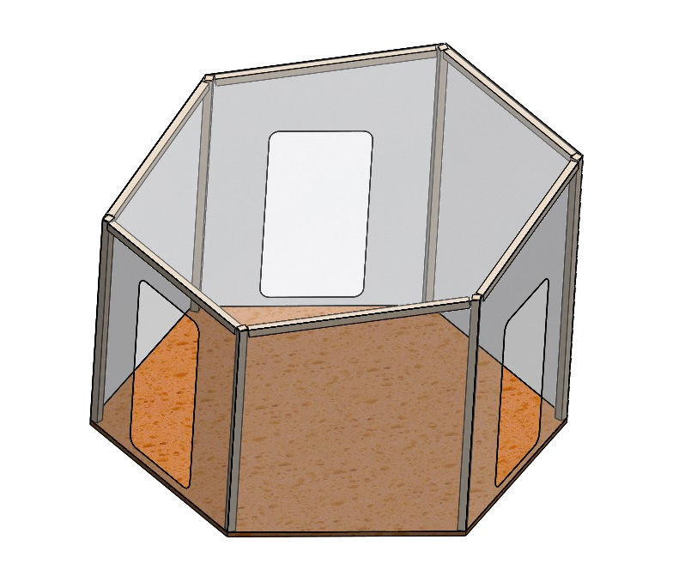
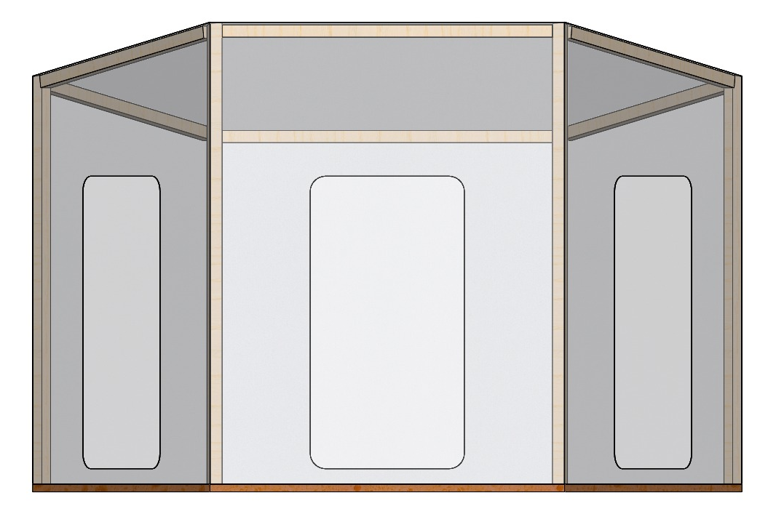
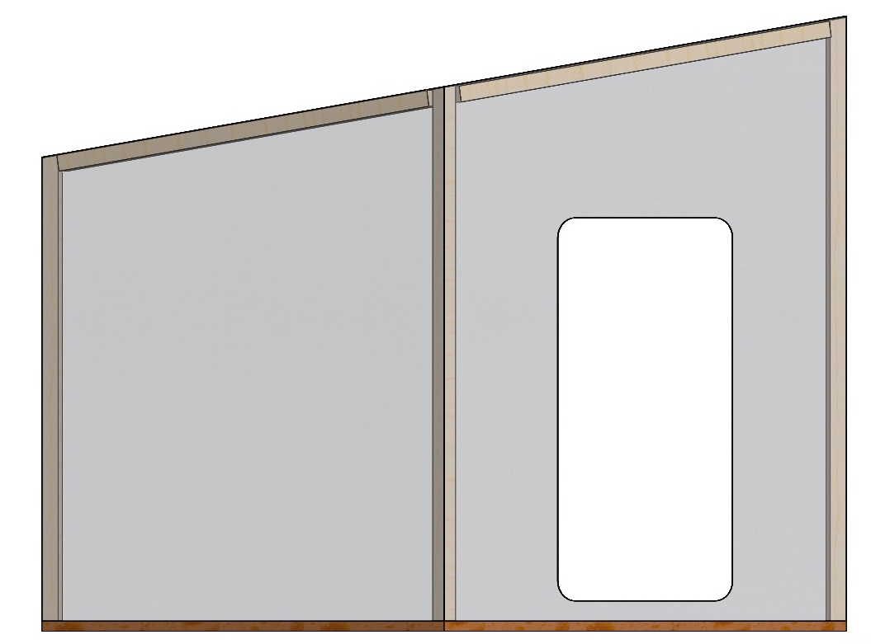
Design Shelter

Slide 3
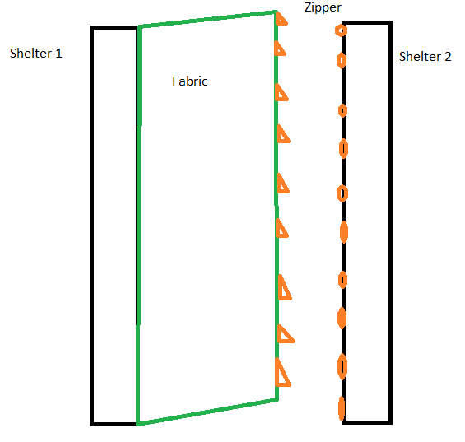
Door /
Connection
Zipper
Fabric
Cheap and easy to repair
Security
Lock
Necessary?

Slide 4
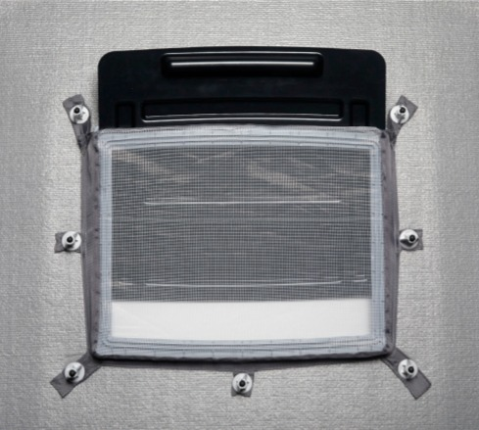
Ventilation
Outer frame
Slide-open hatch
Mosquito net
2 frames per shelter

Slide 5
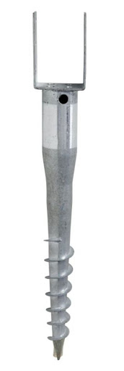
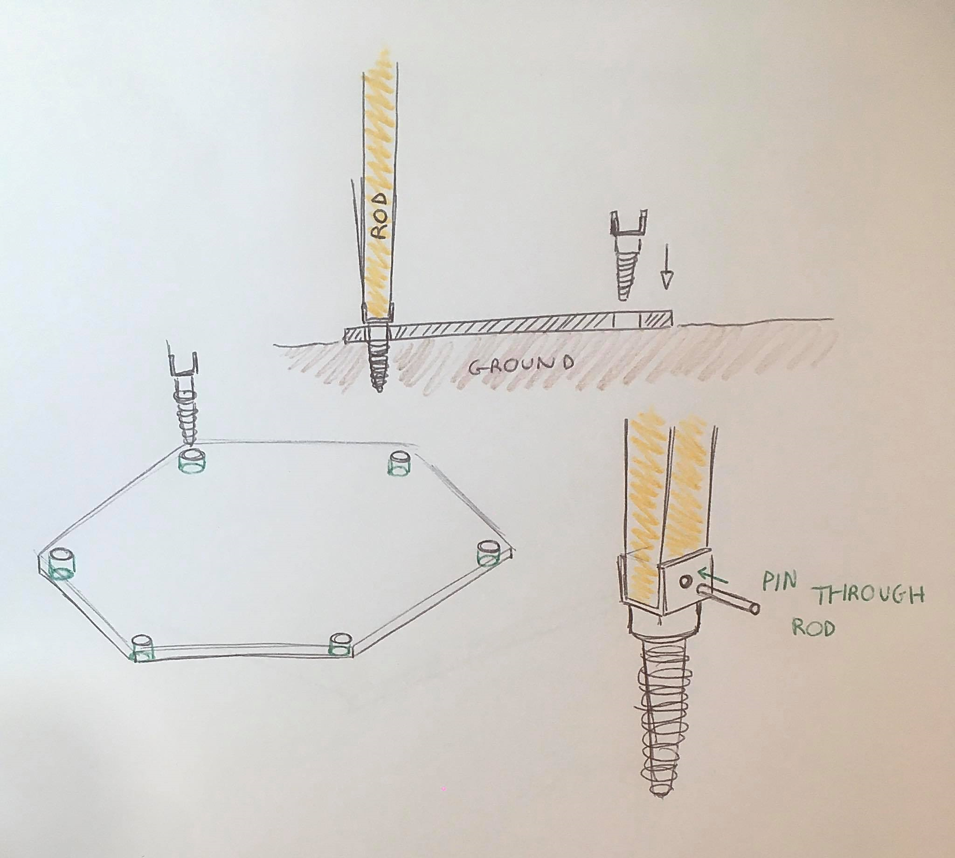
Ground fixations
Ground screw with pin
Ground – Floor – Rods

Slide 6
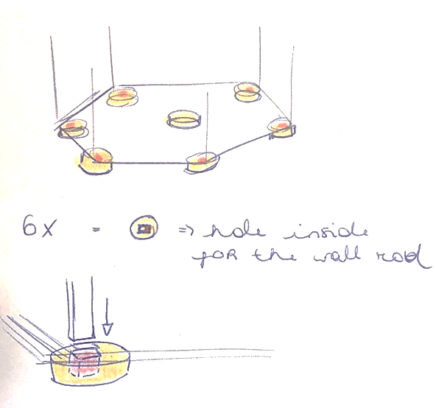
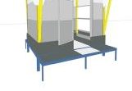
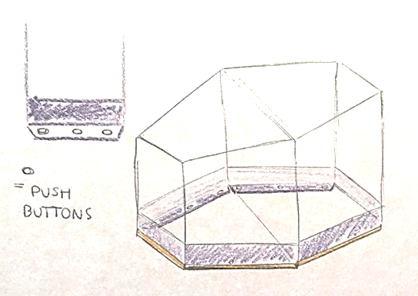
Rain resistant
Legs
Blocks (metal, concrete)
Additional layer:
Water resistant fabric

Slide 7

Our questions
List of materials
Prototyping
Video

