Slide 1

7th Meeting

Slide 2
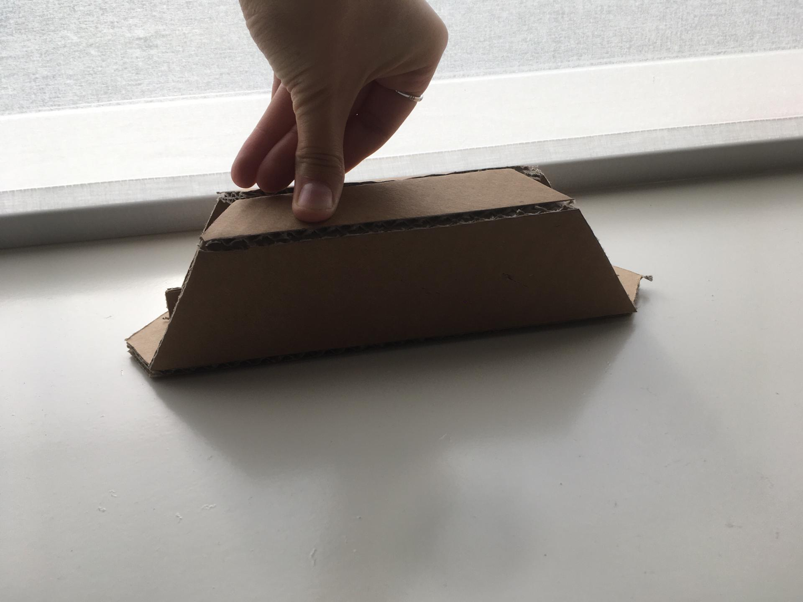
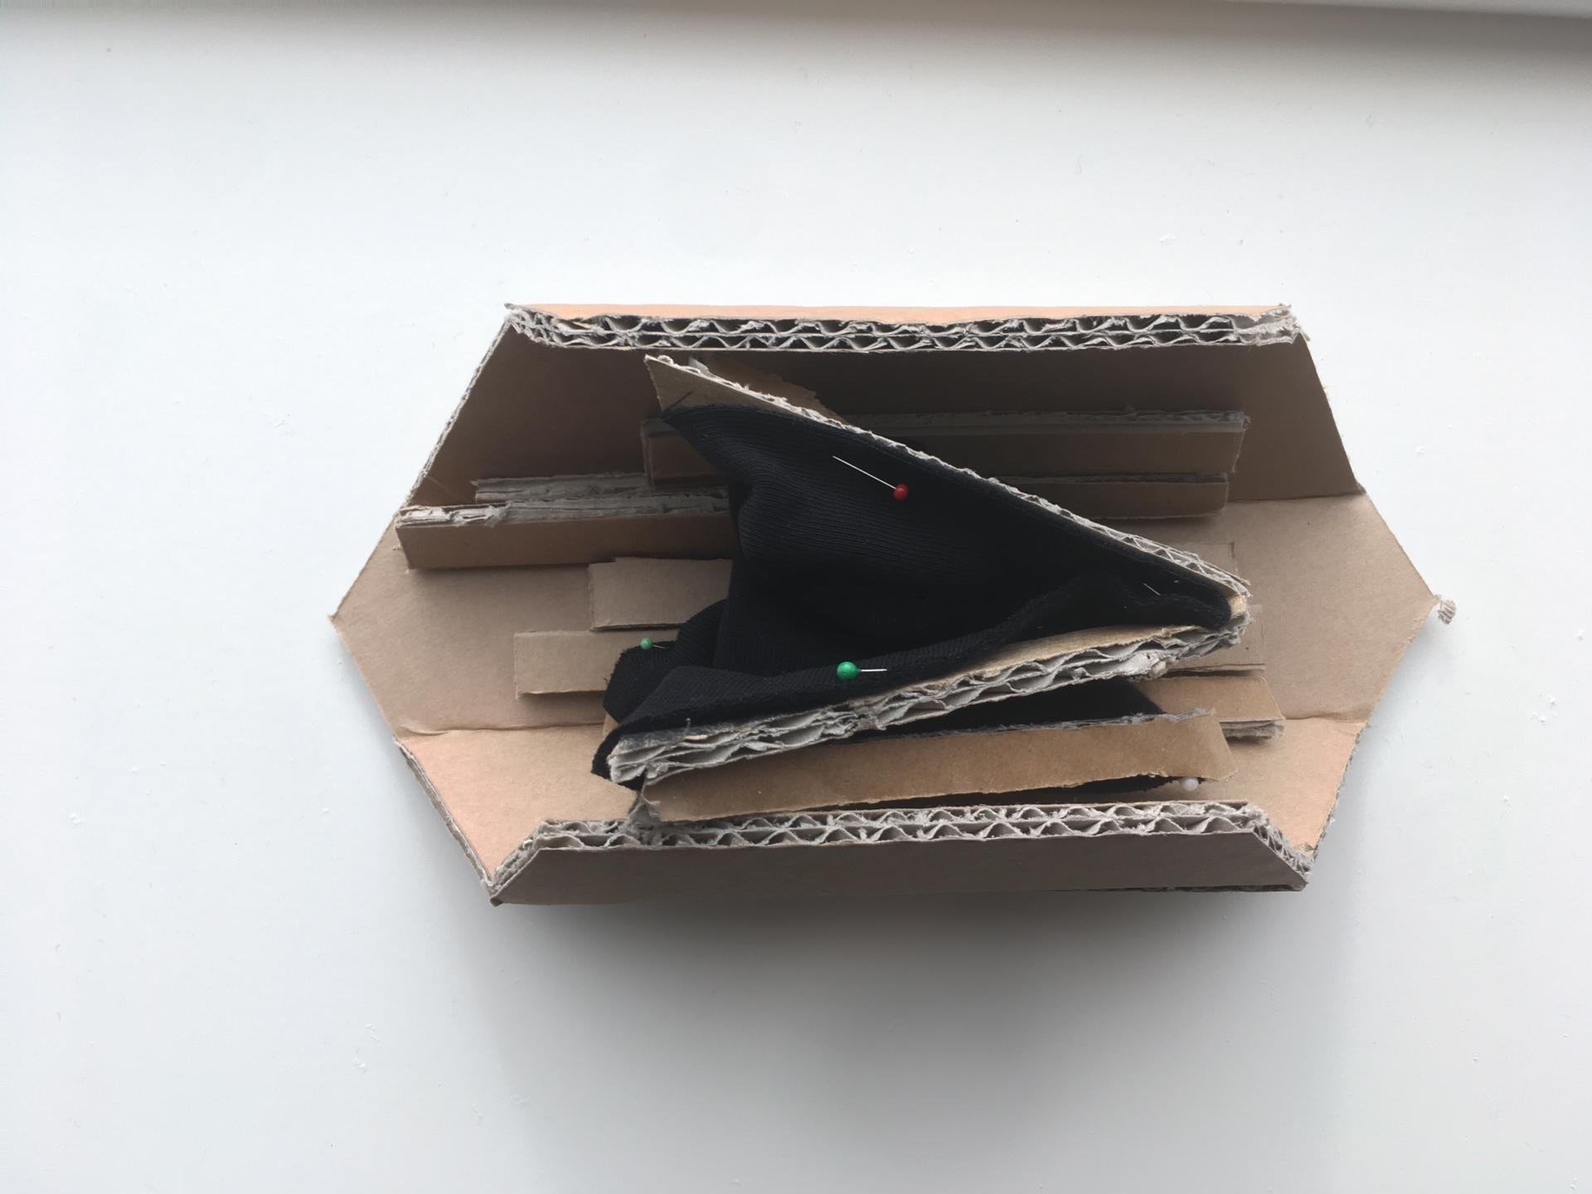
FLOOR
Rigid -CORK PANEL
Foldable-HINGES

Slide 3
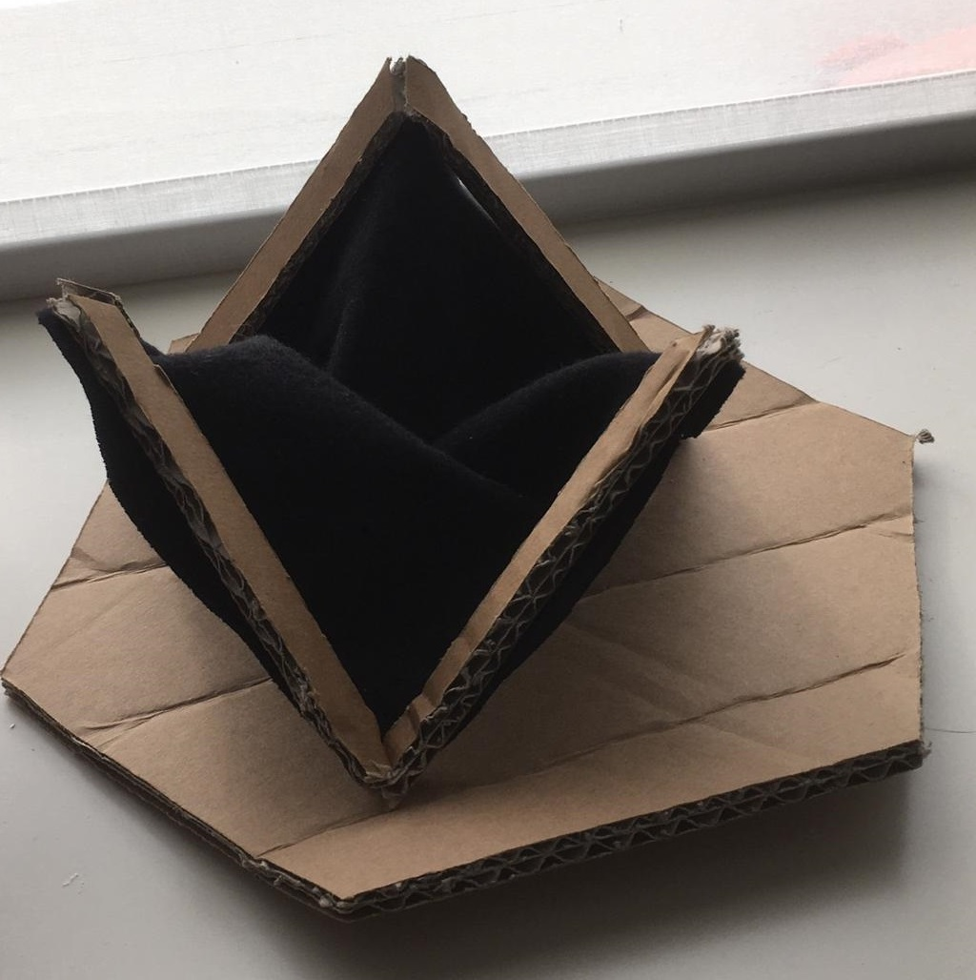
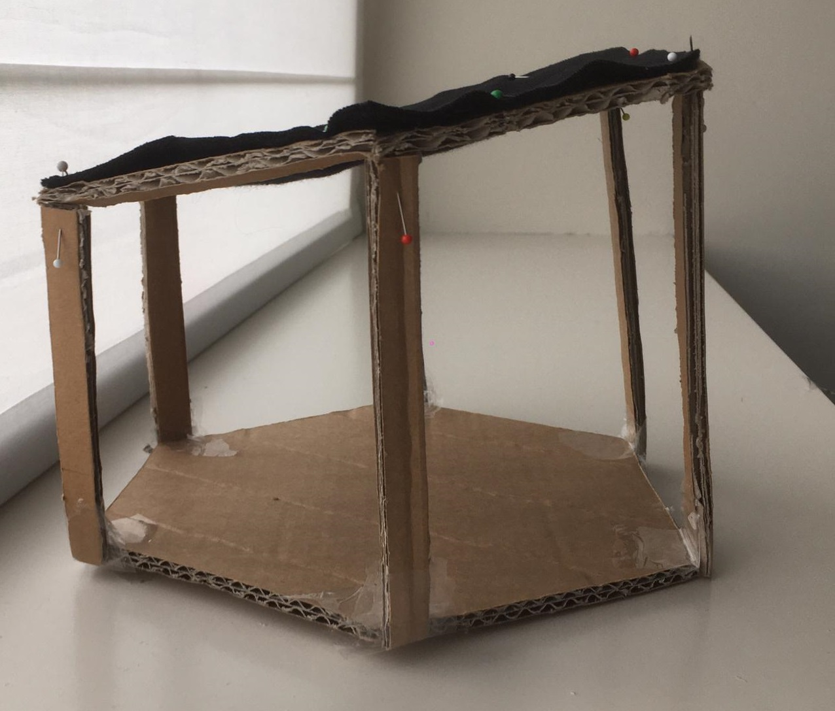
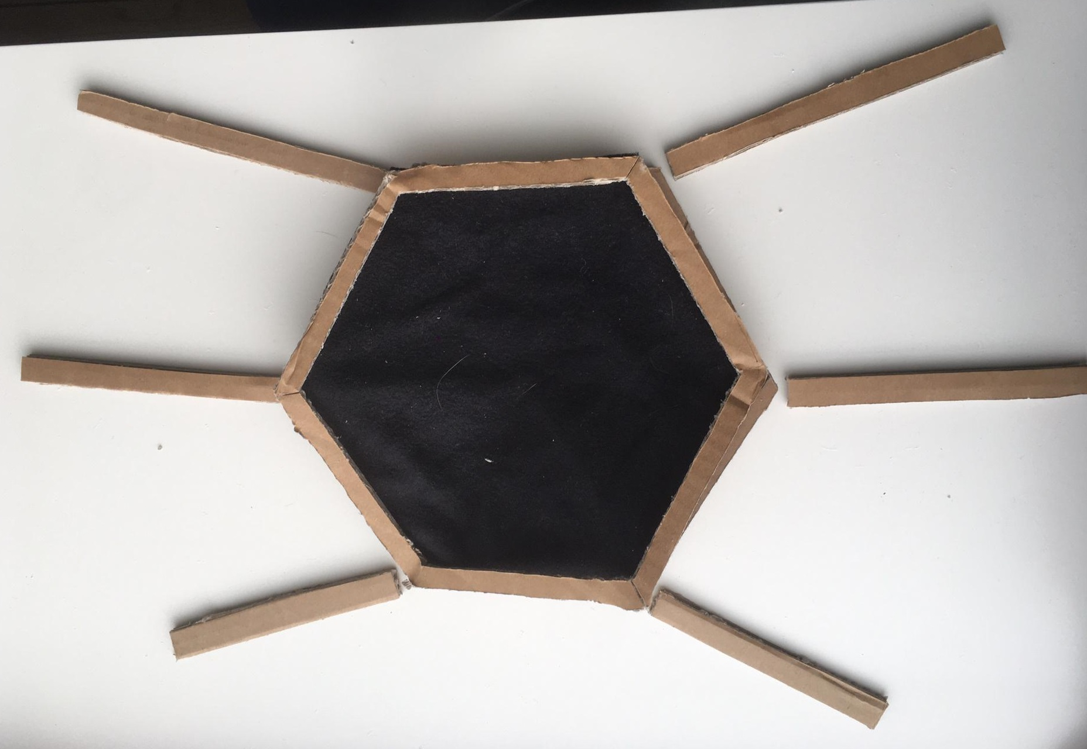
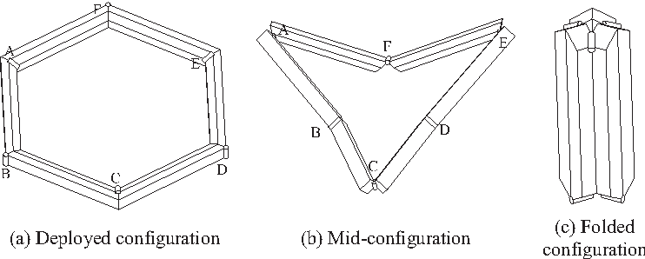
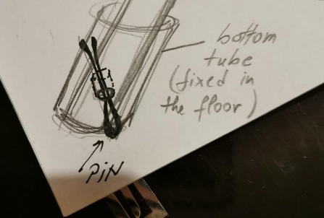
2 x 2.3 m
2x 2.65 m
2 x 3 m
Slope

Slide 4
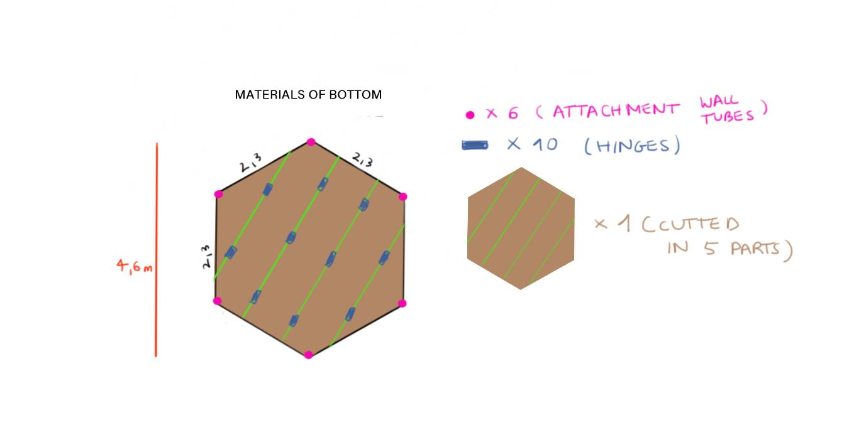
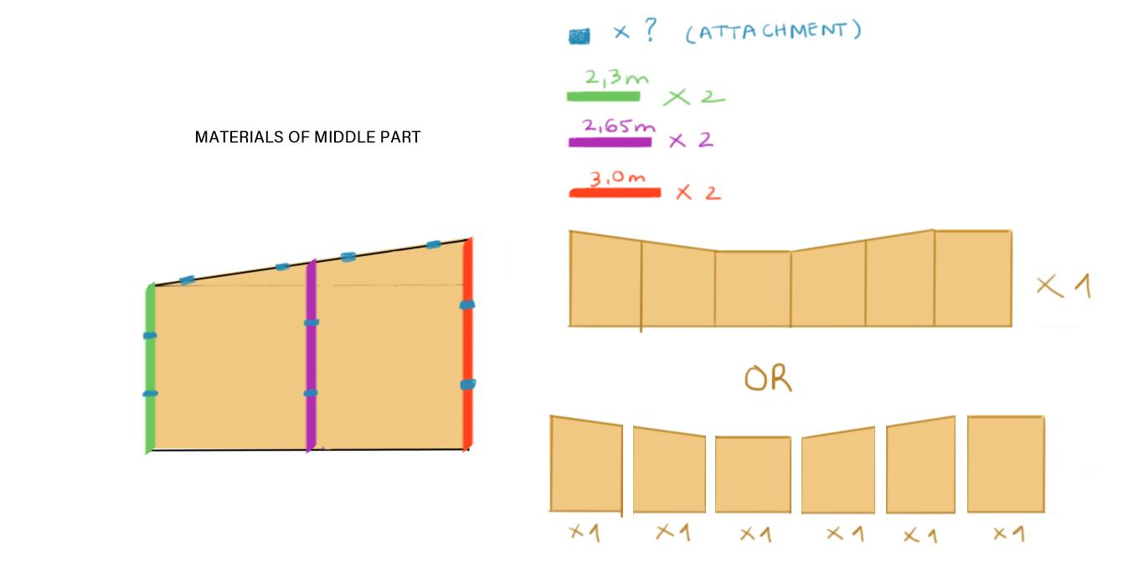
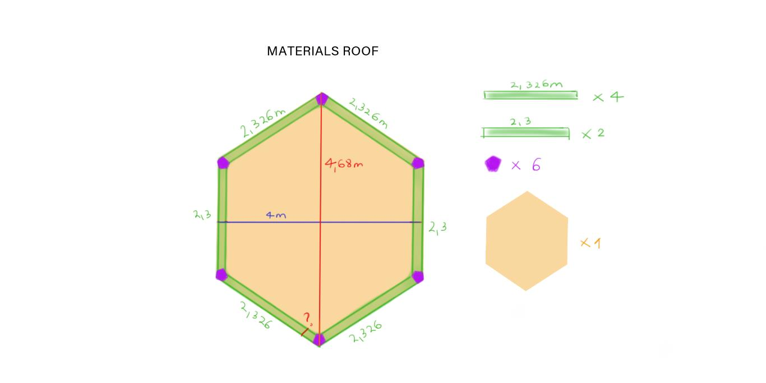

Slide 5
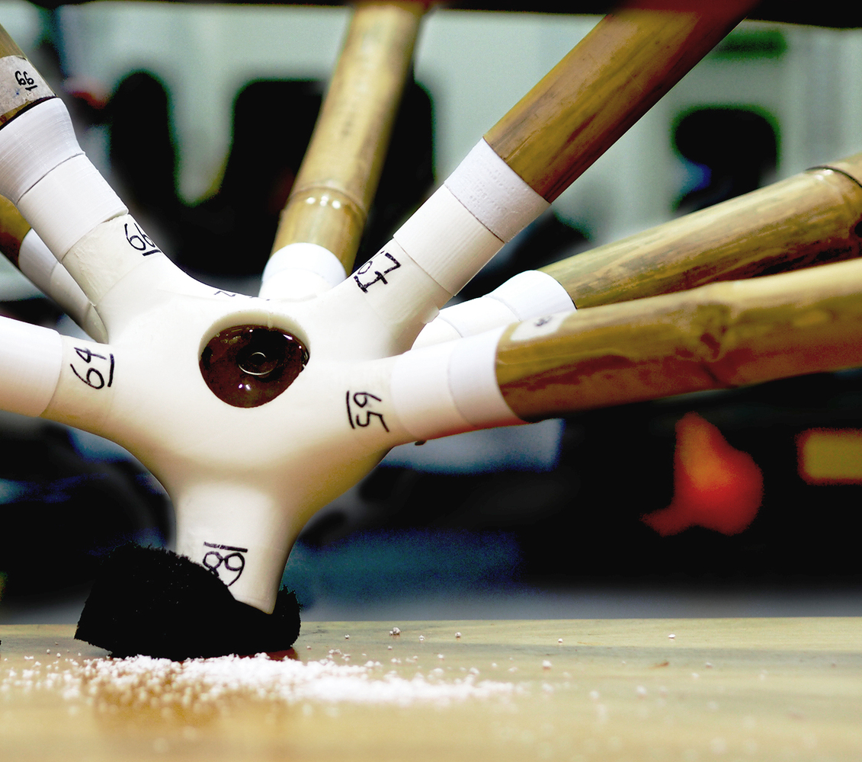
Agenda
Can we create our own elements of connection between the shelter tubes?
Can we create the joints using a 3D printer or something else?
Do we need a list of materials for the real product and also for the prototype?

Slide 6
TO DO
To find the suitable connectors for the tubes
To finish the 3D model

