Slide 1
Meeting disaster shelter
Speaker: Andreea & Lore

Slide 2
Table of content
Scope
Blackbox
Design Concepts

Slide 3
SCOPE
Warm, safe area away from disaster
2 weeks to stay in the shelter
Foldable but modular
Furniture
Walk space (1m^2)
“Make people feel like home”

Slide 4
BlackBox
FOLDING MECHANISM
SEALING SYSTEM
VENTILATION
THERMAL PROTECTION
ATTACHMENT SYSTEM
CUSTOMIZABLE
Storage & portability
Ergonomic closure
Recirculation of air
Materials for inside and outside thermal protection
Modular & fixation on the ground
Entertainment

Slide 5
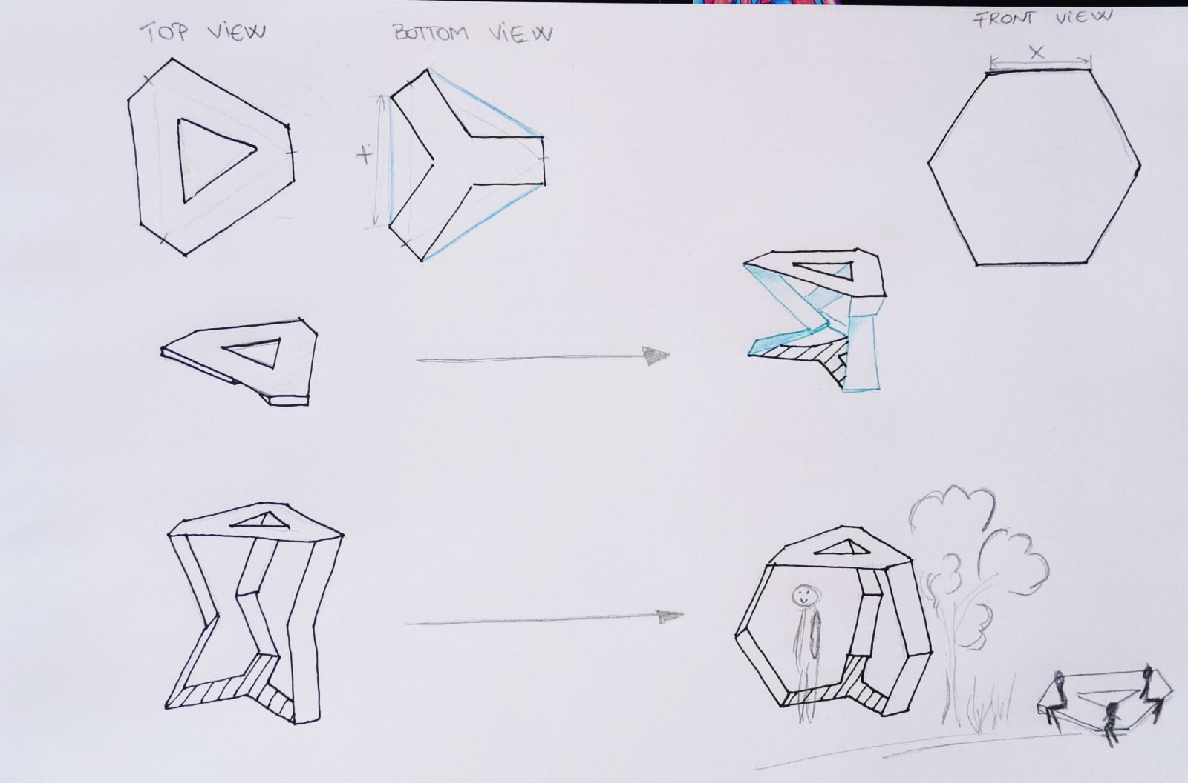
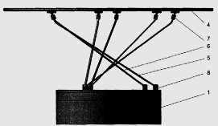
Design concepts
From BENCH to SHELTER
+ innovative
+ multifunctional
- not compact
hard to stabilize (folding mechanism)
1. Lever system
2. Height adjustment thru rotary system

Slide 6
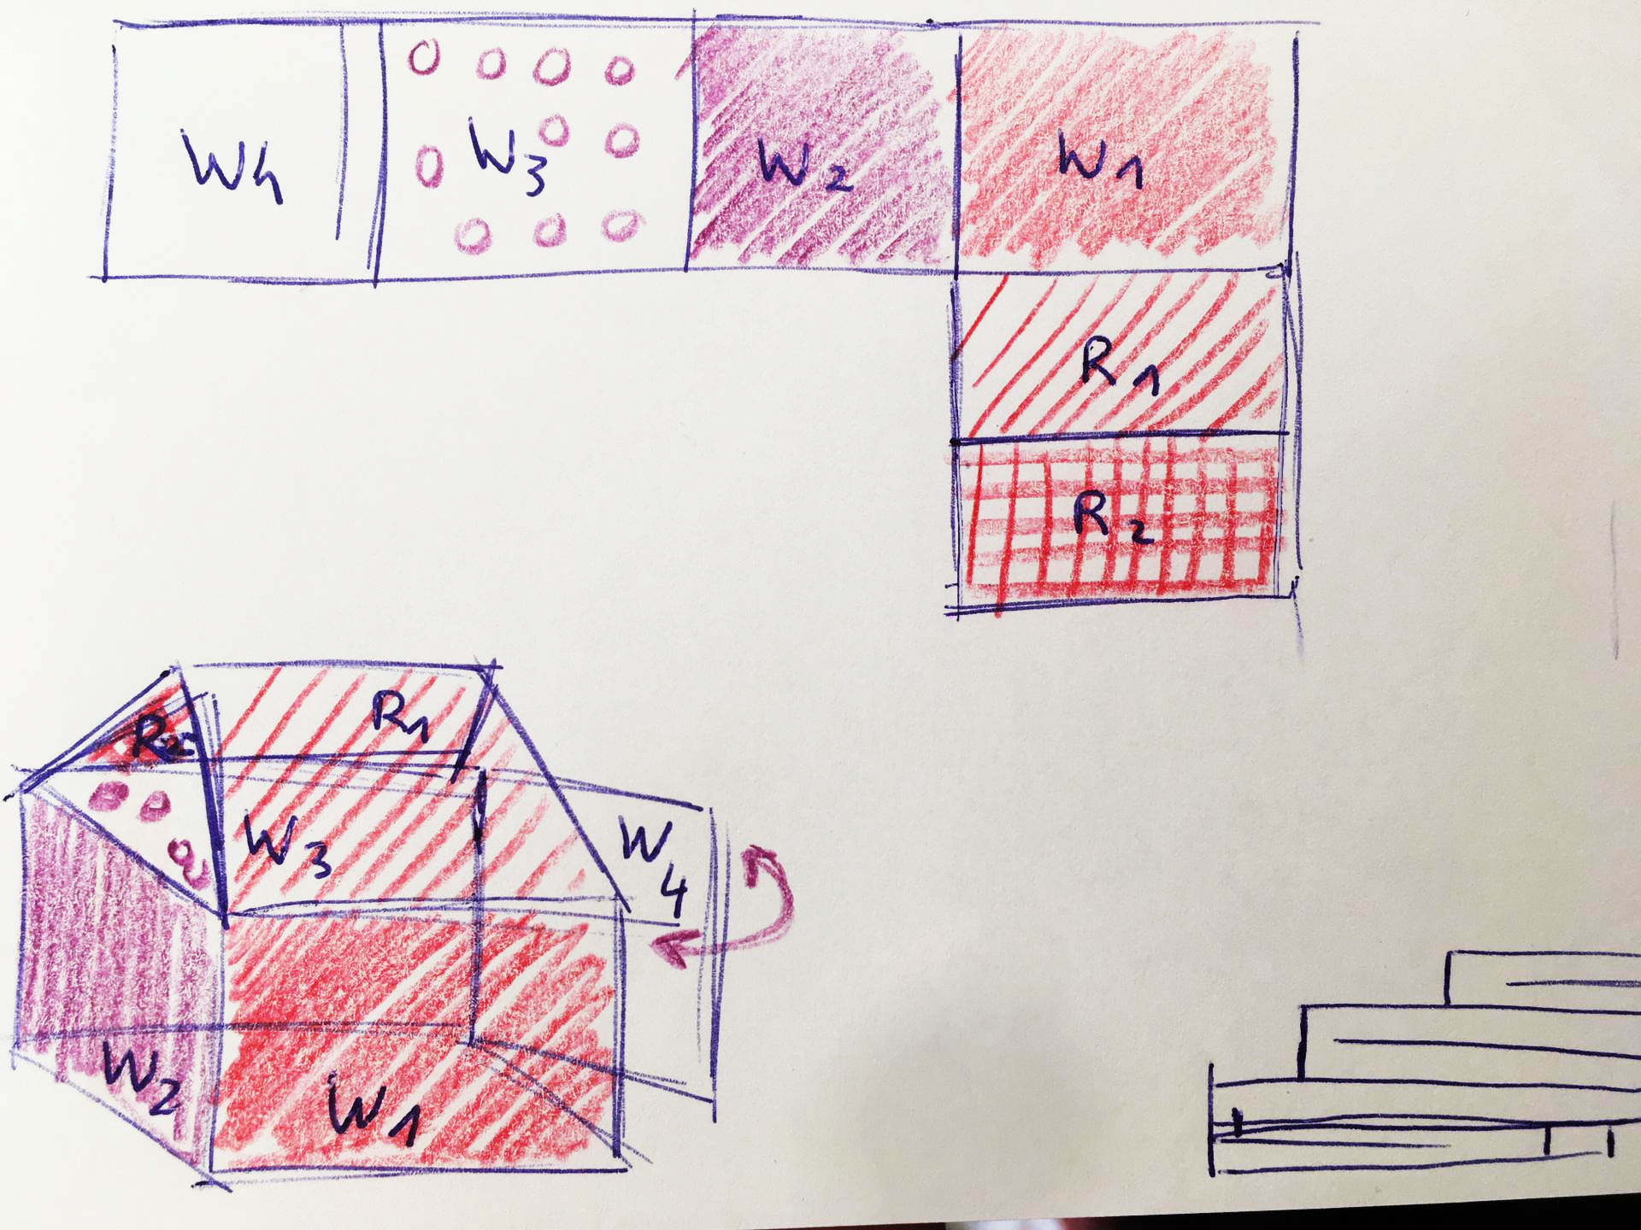
Design concepts
Cardboard tent
+ Freedom in design
+ Easy to fold/unfold
+Portable
- Difficult to attach every side

Slide 7
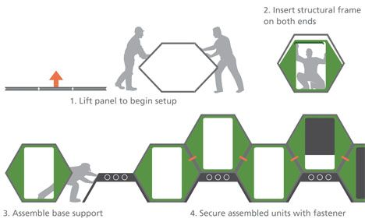
Design concepts
Honey comb design
+ Compact
+ Accordion design
+ Reduce used area
- Hold up system (base support)
- Not really modular
Notes:
S

Slide 8
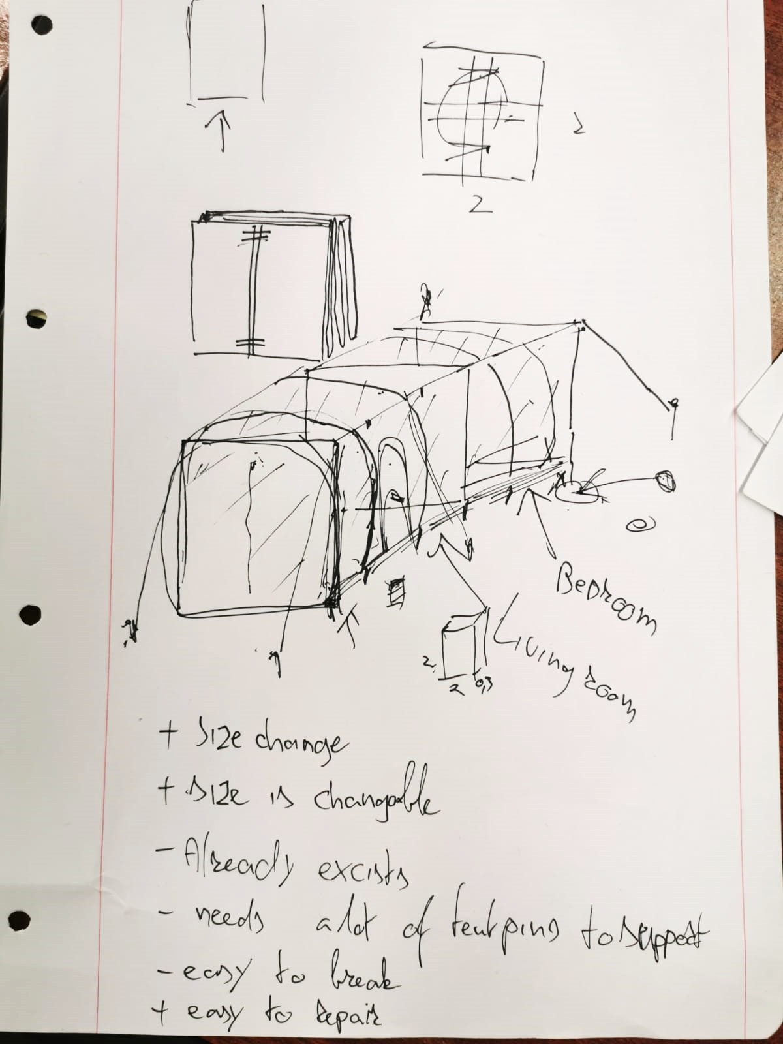
Design concepts
Inflatable worm
+Easy to fold
+Portable
-Fragile
-Stabilization

