Slide 1



15th Meeting
SafeBIS Shelter
Team 3

Slide 2
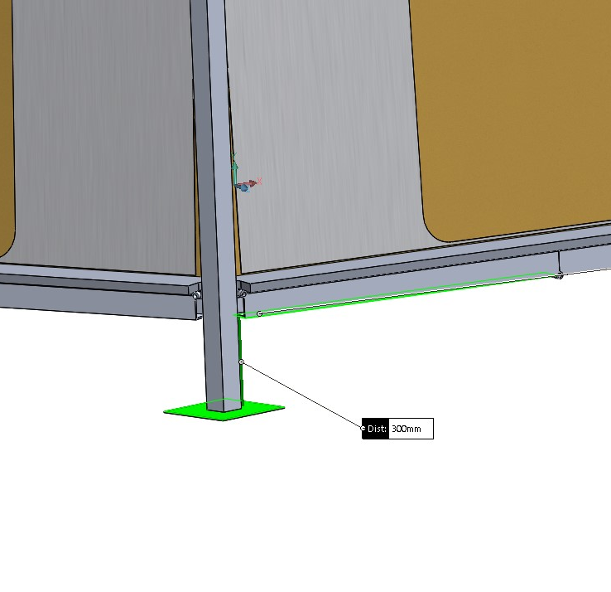

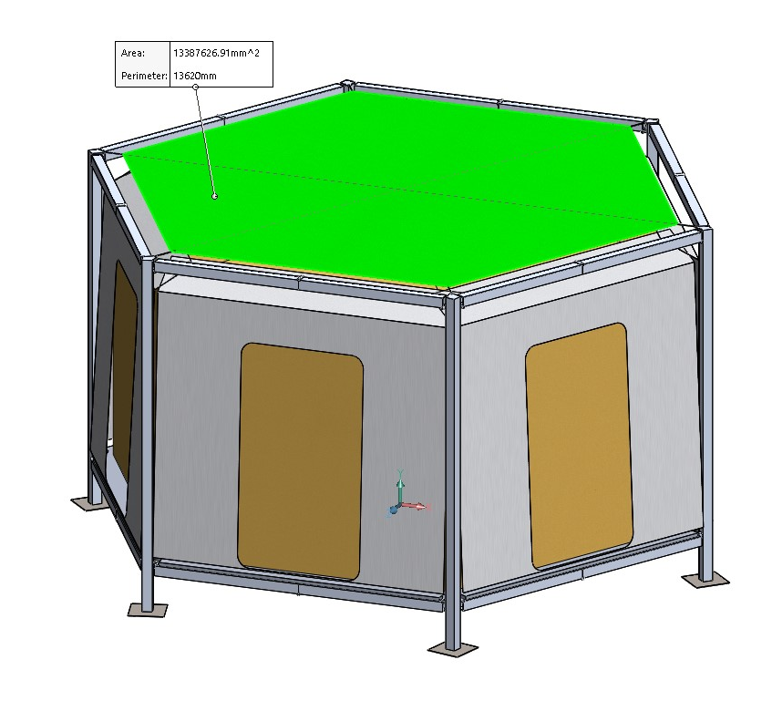
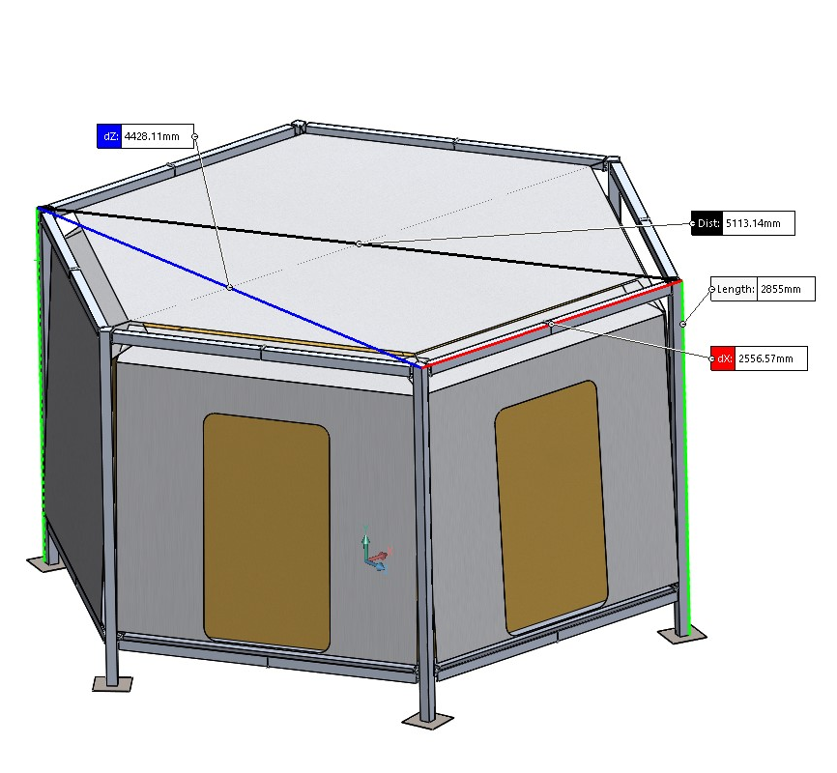
Functional Testing
Space Requirements by the UNHCR
3.5 m²/person=>3.5 x 4 = 14 m²/4 persons
Dimensions of the SafeBIS Shelter
roof fabric=13.39 m² (side=2.27 m)
short diagonal=4.43 m
long diagonal=5.11 m
beams: side=2.55 m; height=2.85 m
distance to elevate the shelter= 30 cm

Slide 3
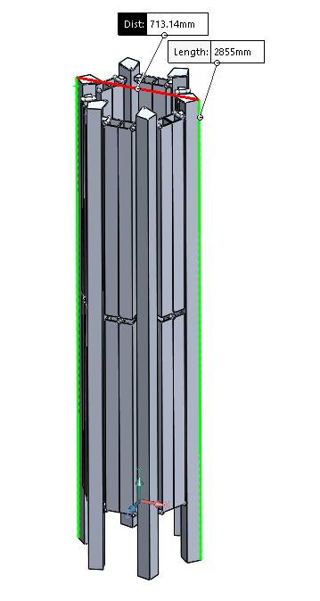
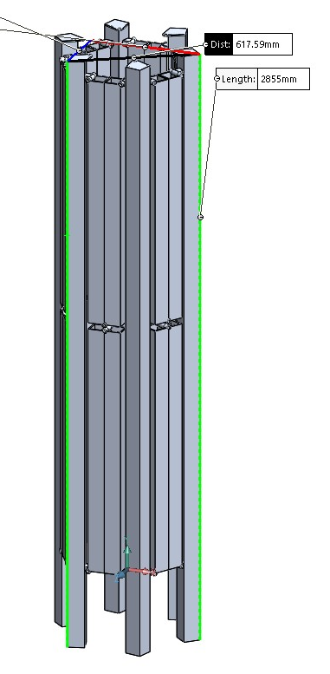
Folded Structure

Slide 4
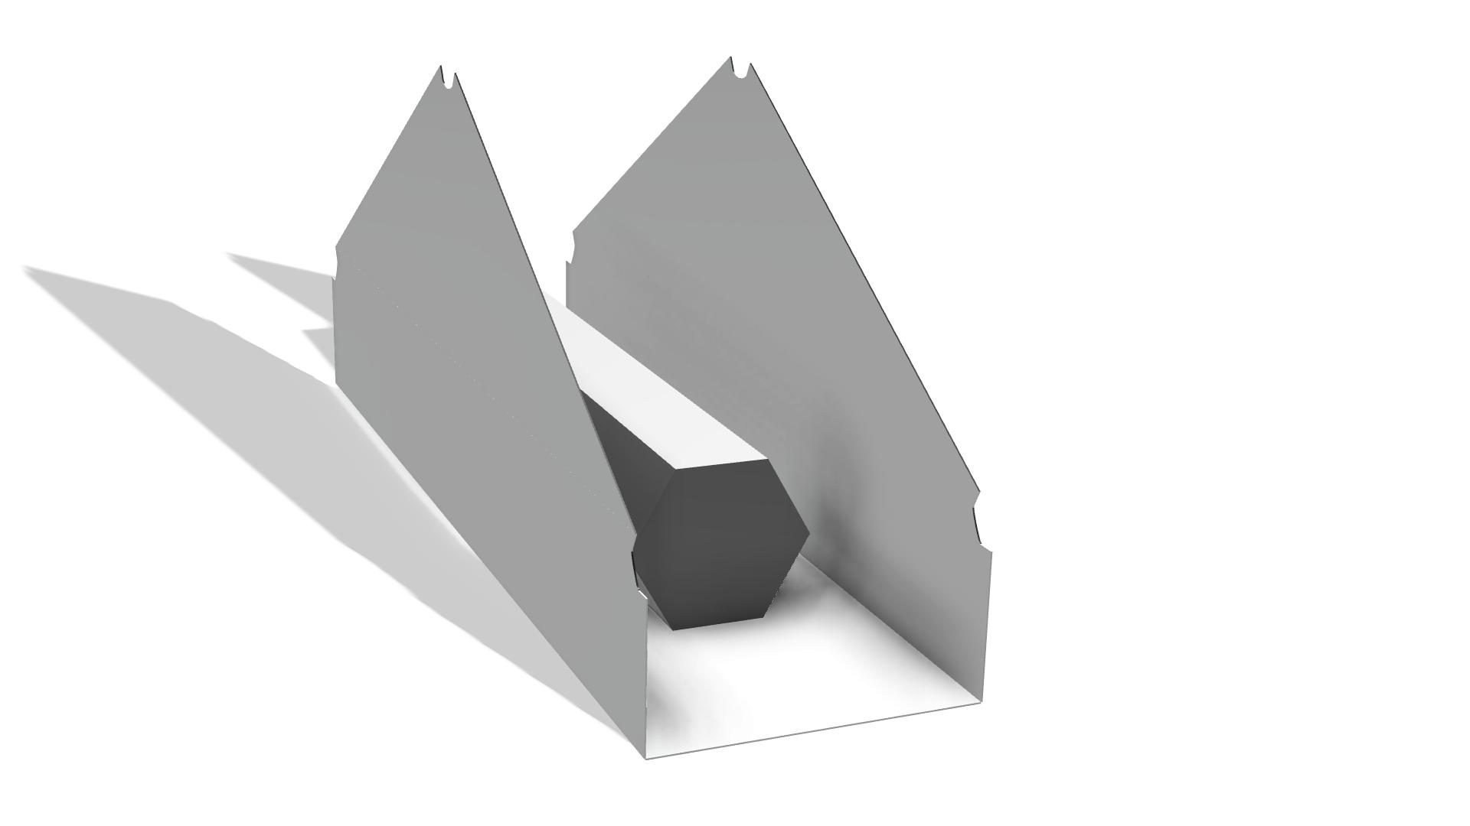
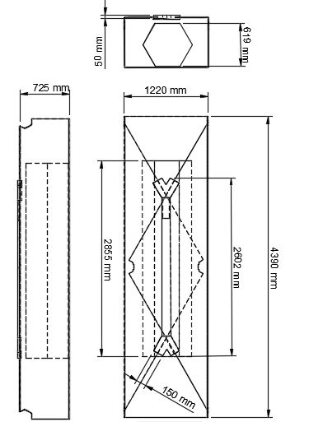
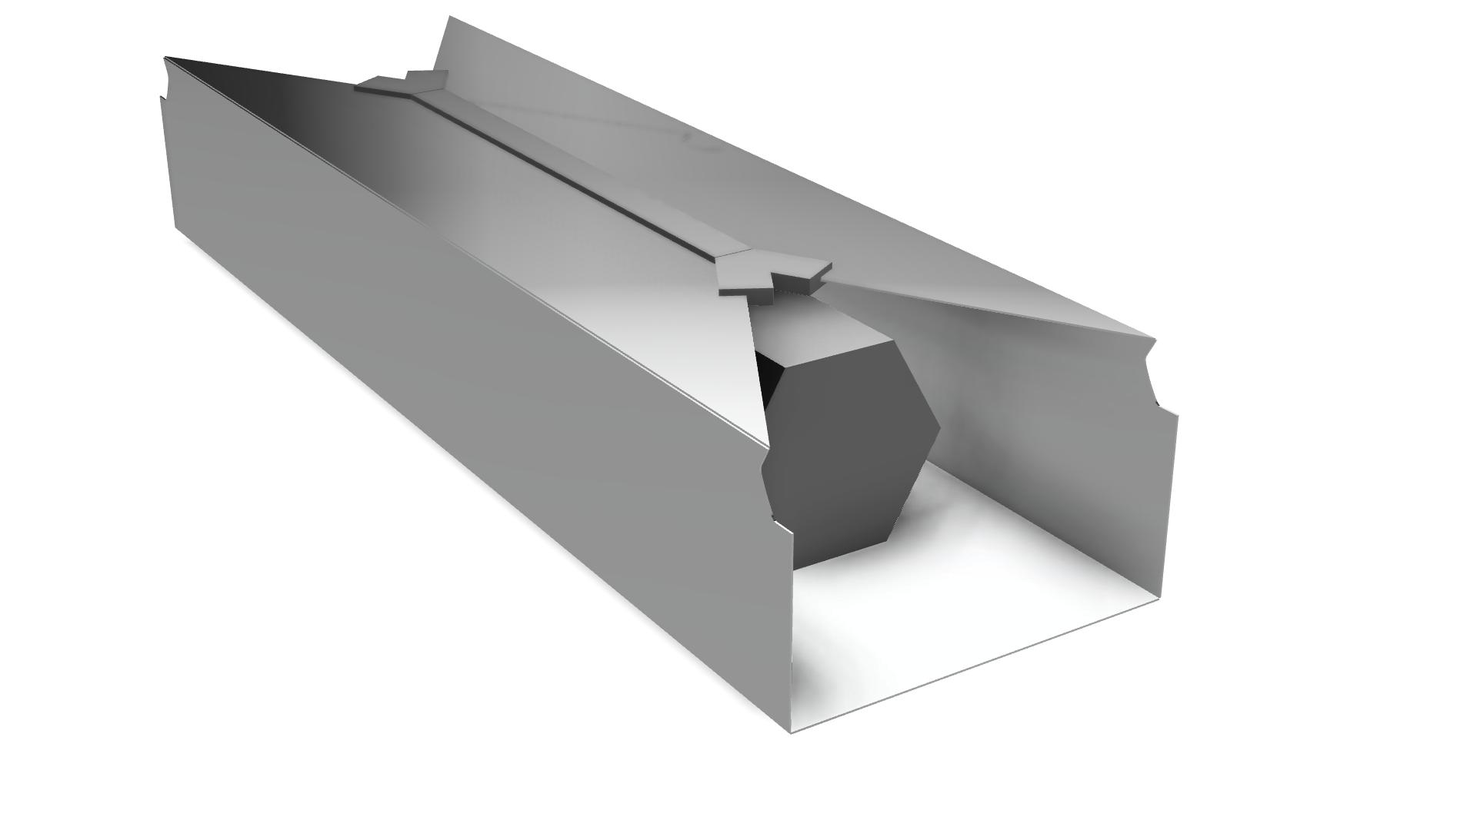

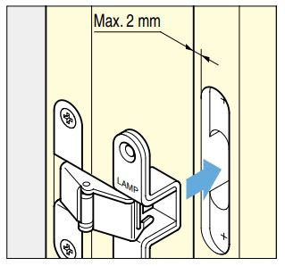

Slide 5
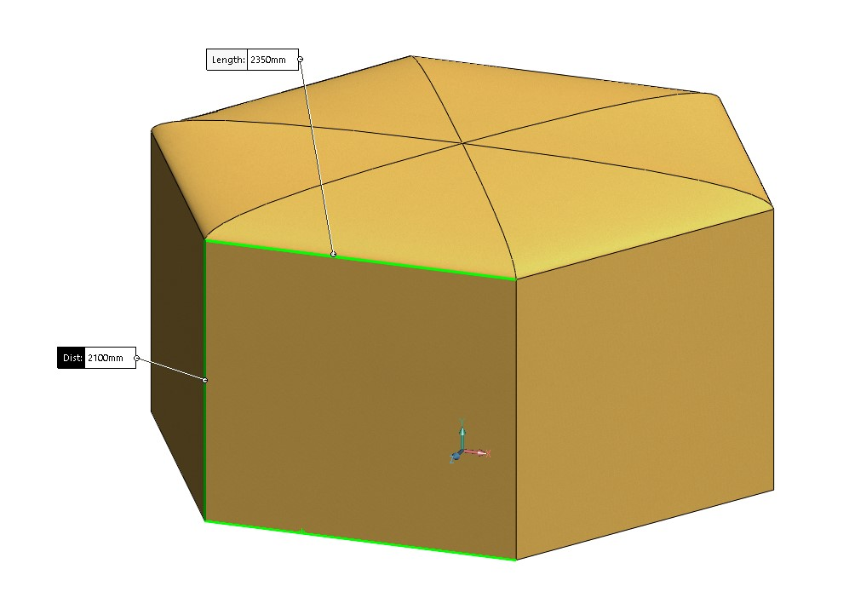
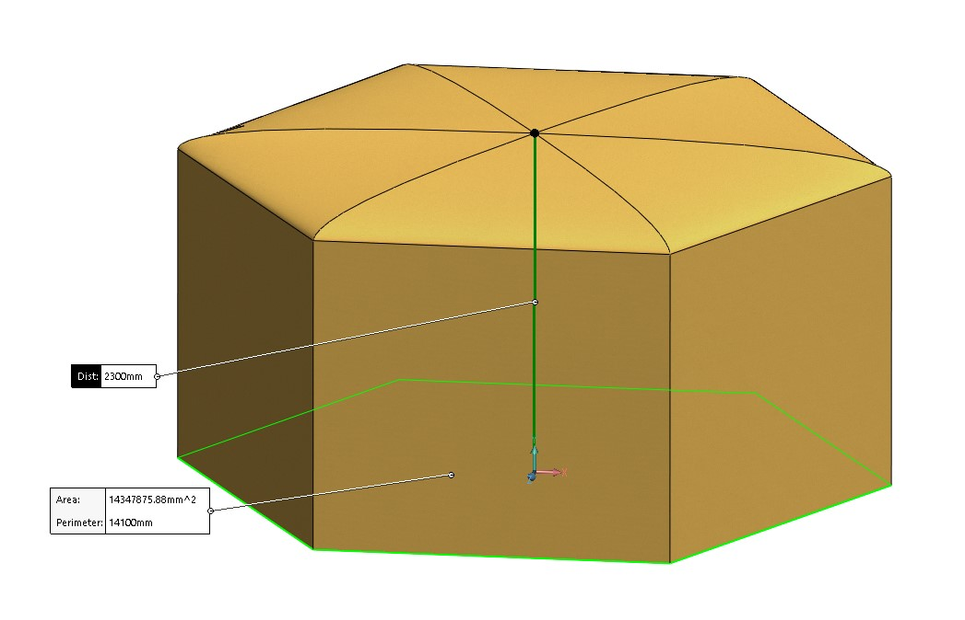
Fabric Tent
Side=2.35 m
Wall height= 2.1 m
The highest point= 2.3 m

Slide 6
Simulation
Our Load Requirements:
-Our shelter will house 4 persons of interest and their belongings.
This is assumed that as an average value for the mass of a male occupant, the worst-case scenario, would be 85 kg and the belongings, beds, and possible furniture as a total mass of 50 kg.
This results in a load of:
4 x 85 +50 = 390 kg
With an estimated initial floor thickness of 20 mm, a corresponding weight of 7.0 kg/m² and a floor area of approximately 16.5 m² the added weight of the floor is:
7 x 16.5 = 115.5 kg
So, the previous value of 390 kg goes up to:
390 + 115.5 = 505.5 kg
To this, there will be a safety factor of 2.0 added that also works to prevent that in the case that extra persons enter the shelter, that are not living in it.
505.5 x 2 = 1011 kg
These 1011 kg will be applied on the floor of the shelter in order to evaluate its strength without failing but also without excessive deflection.
The choice of materials and thickness will be a result of these materials when subjected to a simulated load in Solidworks.

Slide 7
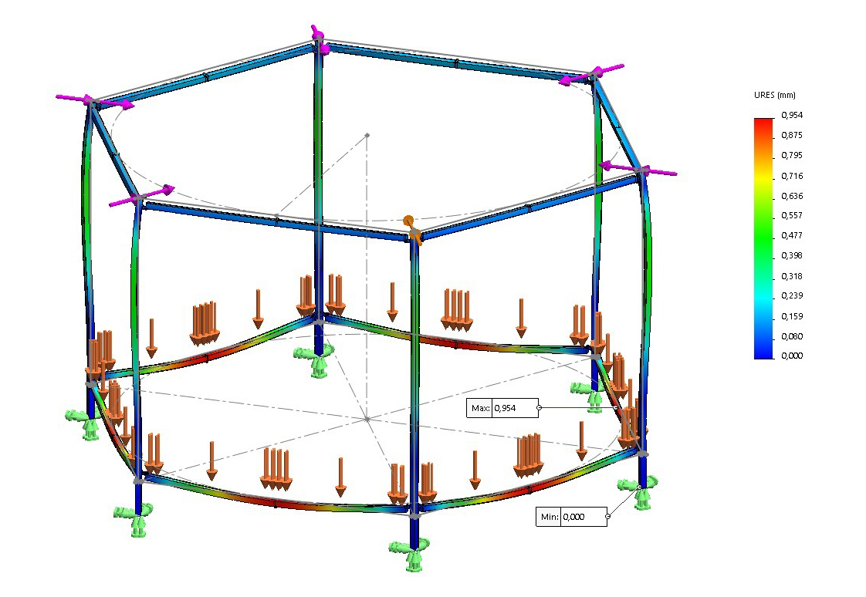

Slide 8
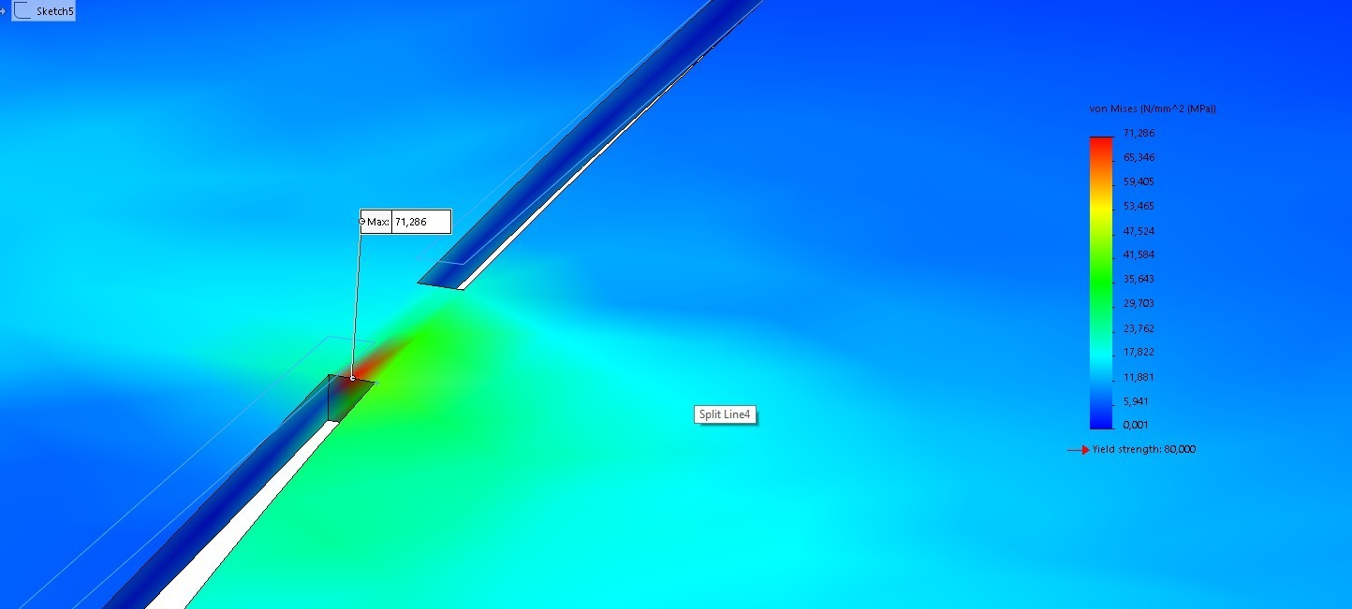

Slide 9
