Slide 1
13th meeting
SafeBIS Shelters

Slide 2
DIMENSIONS
Due to concerns about the weight of the shelter it was changed to 3 occupants per shelter -> New Dimensions for the base and roof
  Minimum Roof Height – from 2,3 m to 2 m
  Roof Angle – from approx. 9º to 6º
  Maximum Roof Height – 3 m to approx. 2,5 m
  Floor side – from 2,5 m to 2,1 m
  Resulting Floor Area – from 16,2 m² to 11,5 m²

Slide 3
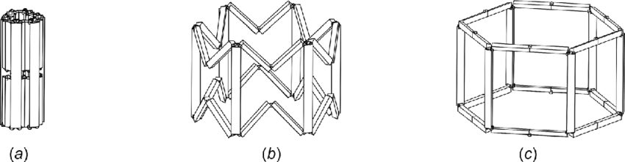
New Folding Mechanism
Solves the previous problem of being a mechanism
But will need to add a locking mechanism to the roof joints

Slide 4
SIMULATION
Load on the floor:
  3 asian men (P95 = 81,0kg)
Load on the roof:
  300 N/m² (ISO8937 - snow load for camping tent)
Buckling of the beams
Withstand Winds of 85 km/h

Slide 5

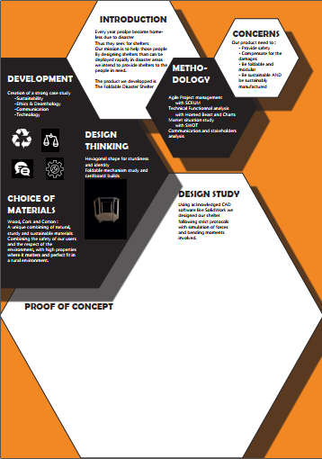
POSTER
First version

Slide 6
DATABASE WEBSITE
https://www.risendevelop.com/elementor-514/#

Slide 7
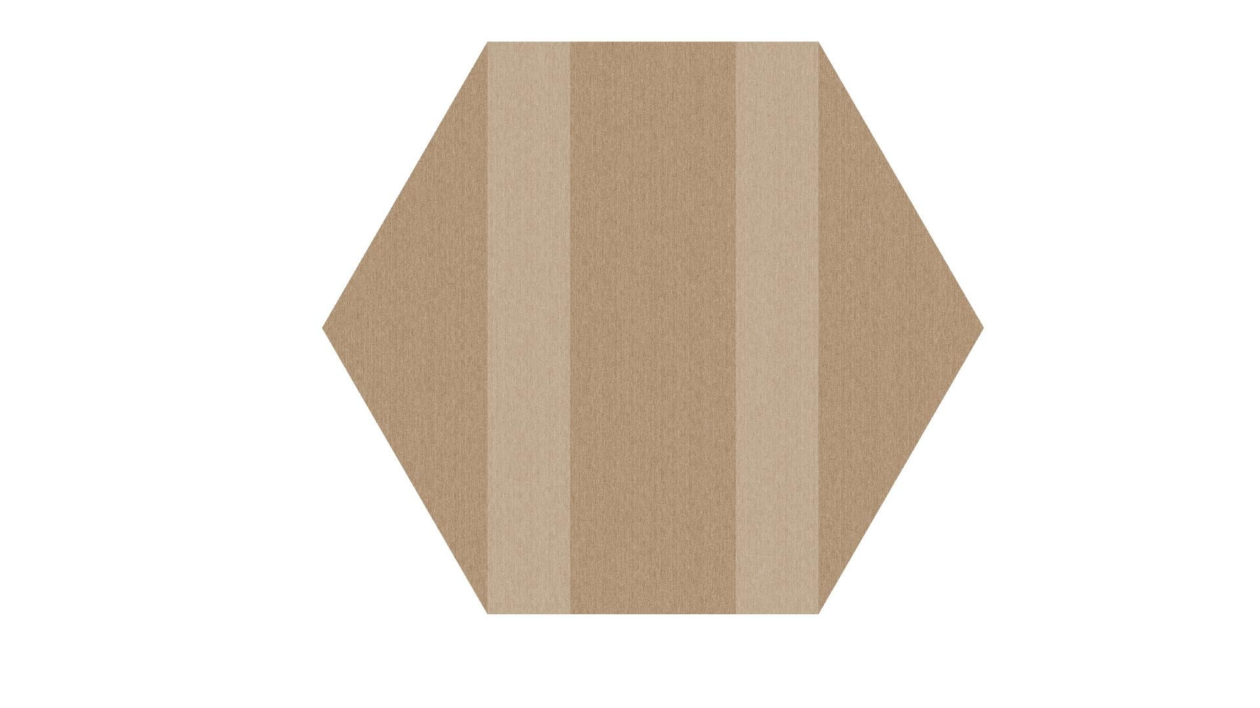
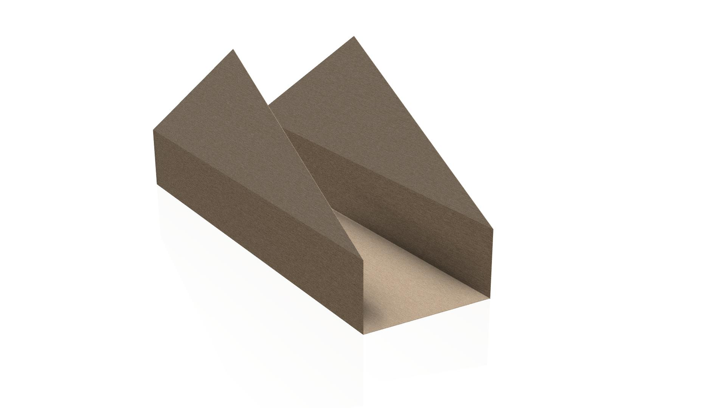
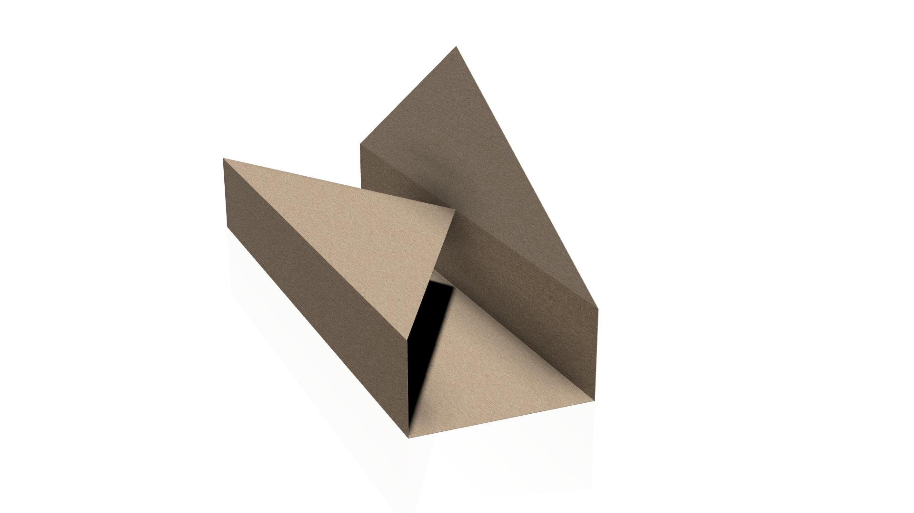
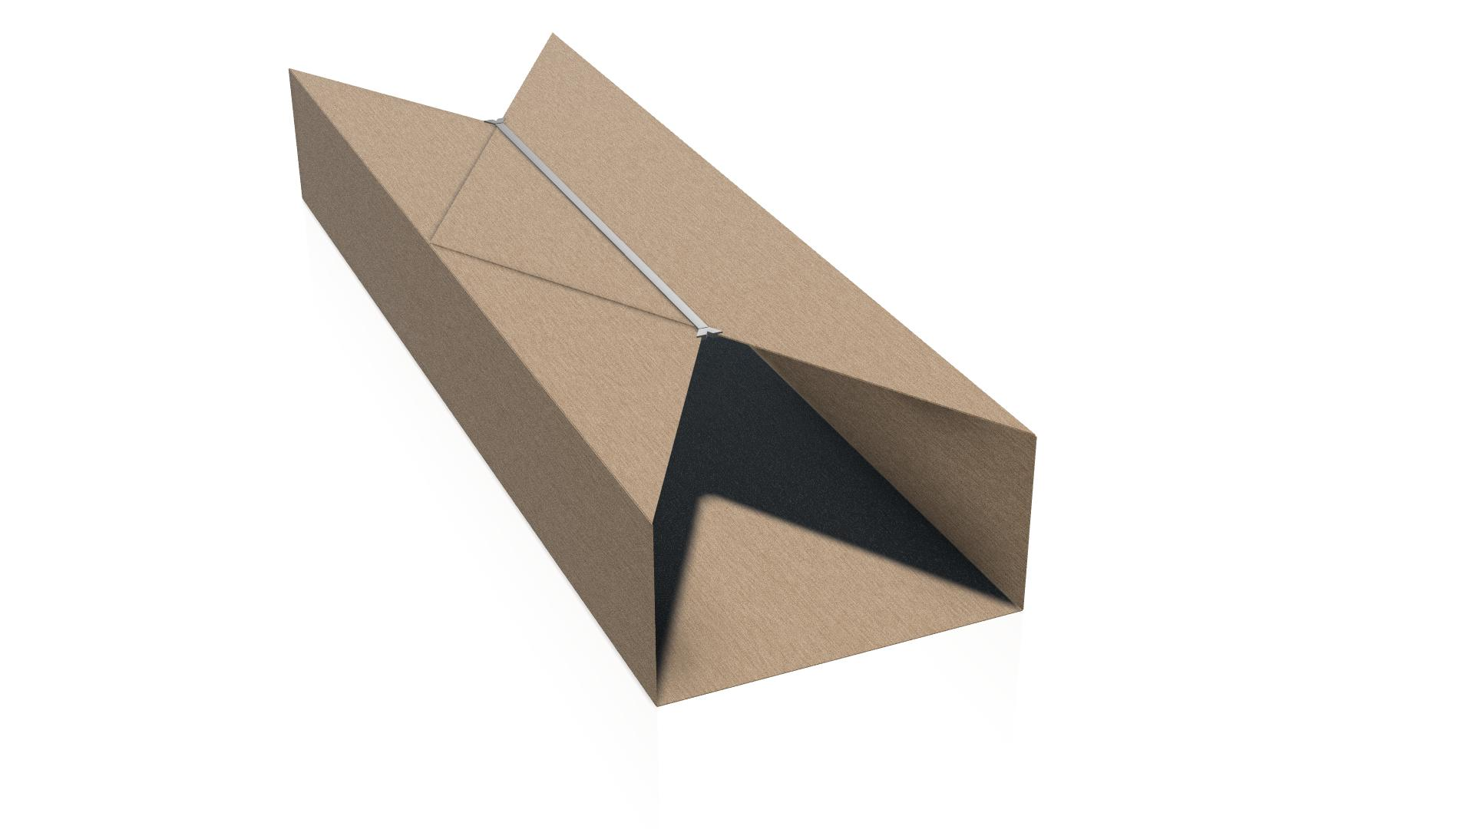
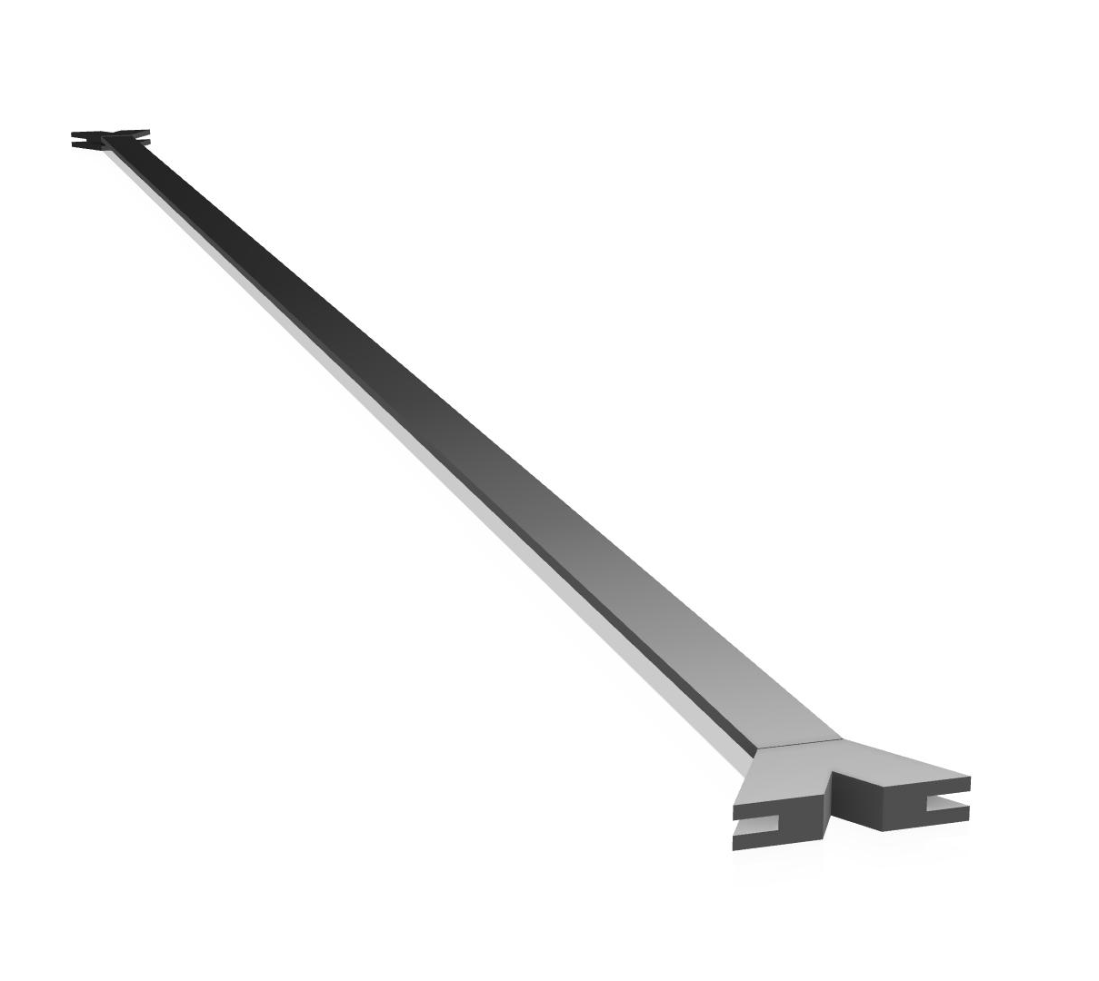
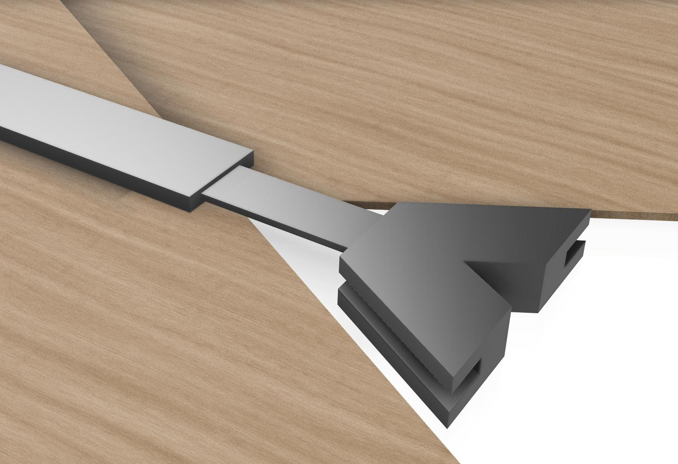
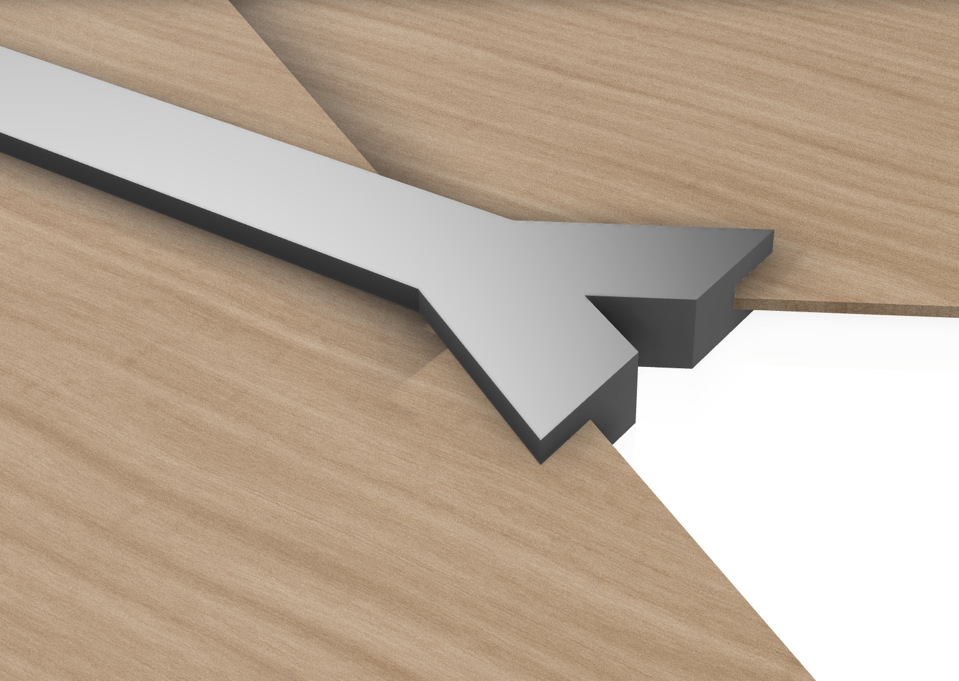
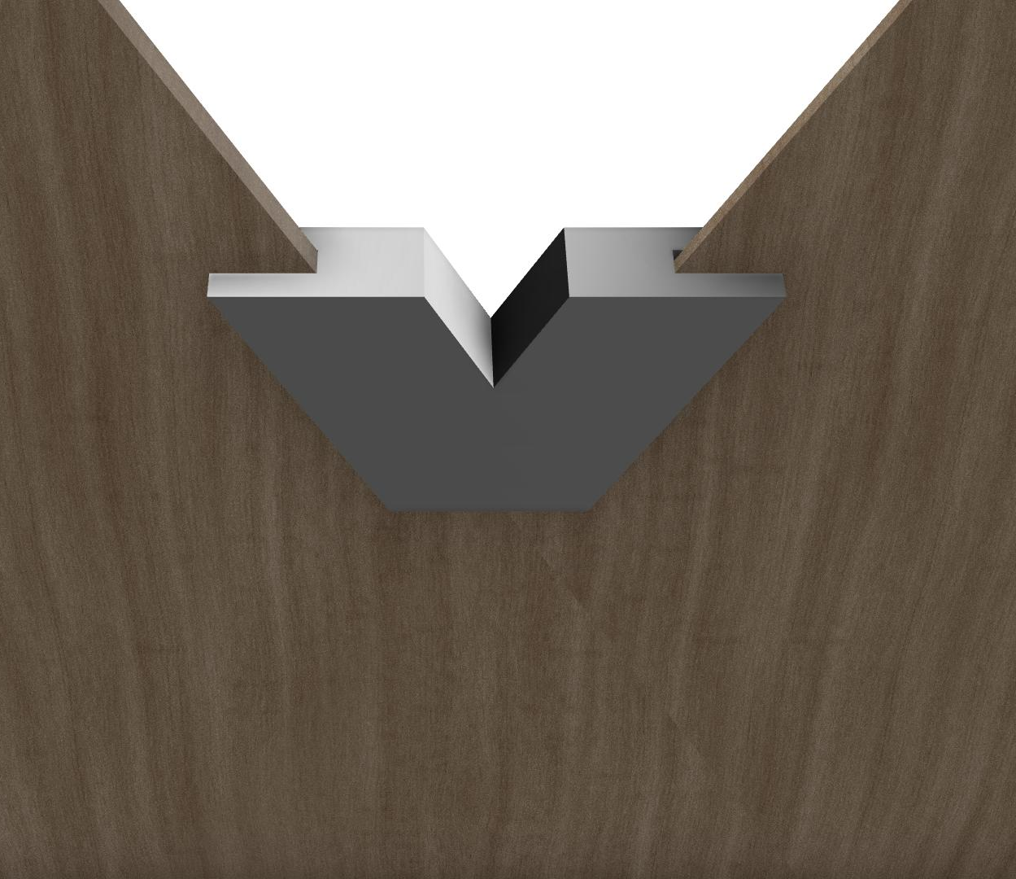
PACKAGING SOLUTION

Slide 8
DISCUSSIONS
Materials for the maquette= Balsa wood/Aluminum pipes
What is the deadline for the maquette?

