Slide 1
Foldable Disaster Shelter
Lore
Andreea
Vladimir
Eduardo
Gabriel
Jelte

Slide 2
CONTENT
Field
Objectives
Requirements
Target audience
Challenges
Structure

Slide 3

1. Field
Safer areas
Warm environment
After the disaster
Notes:
Our shelter is gonna be used in safer areas around the equador(warm environment). The shelter will be used after a disaster accurred. It will compensate for great damages suffered by the victims.

Slide 4
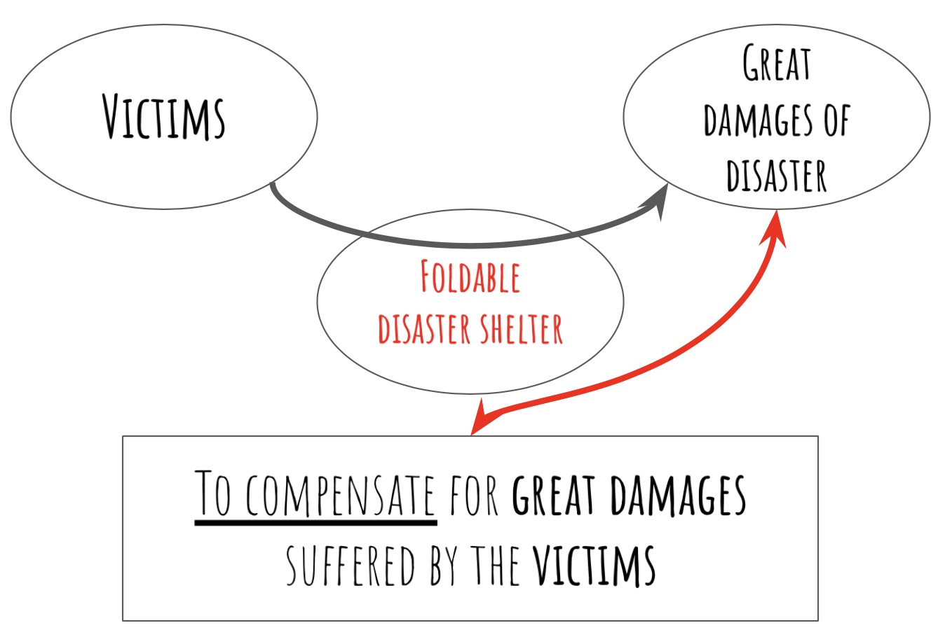
2. OBJECTIVES
Protect victims against environment
-Temperature
-Weather
Compensate for damage of victims
-Living space
-Social
Notes:
We got 2 main objectives. We want to protect the victim from the environment and we want to compensate for the great damage suffered by the victims. To achieve the main objectives we need to fulfill the requirements: Respect/adapt environment, Respect the laws,Adapt to the availability of the skill of the customers or to come with an instruction manual, It has to be sustainable,

Slide 5
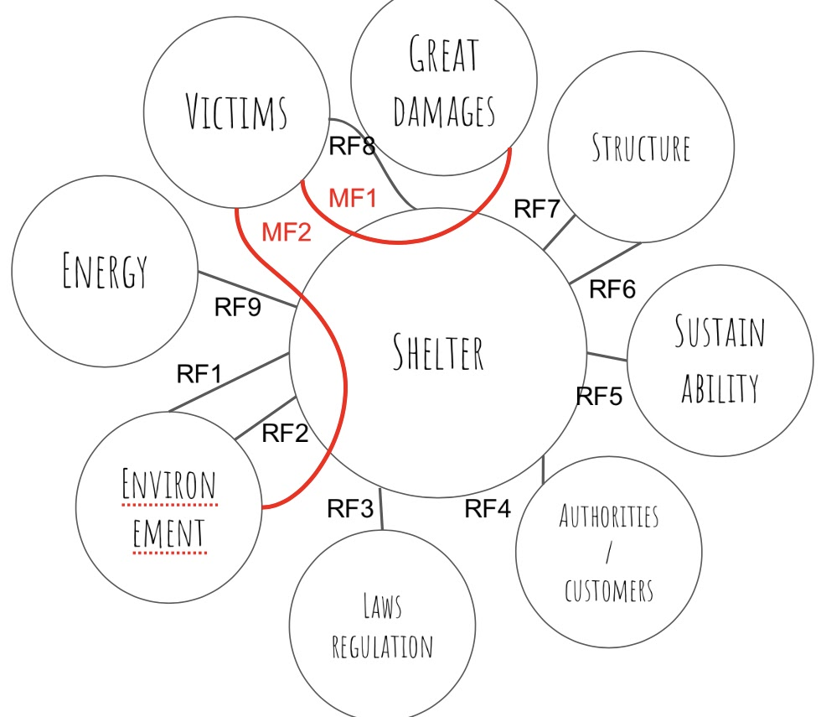
3. REQUIREMENTS
Foldable
Sustainable
Modular
Efficient
Secure

Slide 6
4. Target audience
Customers
-Rescue organisations
-Government
Users
-Refugees
-Victims

Slide 7
5. Challenges
Budget
Time
Level of expertise
Unfamiliar situation
Notes:
During the project we will meet a couple of challanges.

Slide 8
6. Structure
Divert
Research
Design
Prototype
Test
Notes:
To start we will divert the subject to a singular goal. And we will research the goal to design a complete and functionable foldable disastershelter. The design will be realized with an prototype and the prototype will be tested to find the optimal solution.

Slide 9

Obrigado
Fala
Bedankt
Mulțumesc
Merci

