Slide 1

Interim Report:
Foldable Disaster Shelter
BIS • 16/04/2020

Slide 2
General view
Motivation
Main problems
Objectives
Requirements

Slide 3

Progression – Project Management
Resources
&
Quality

Slide 4

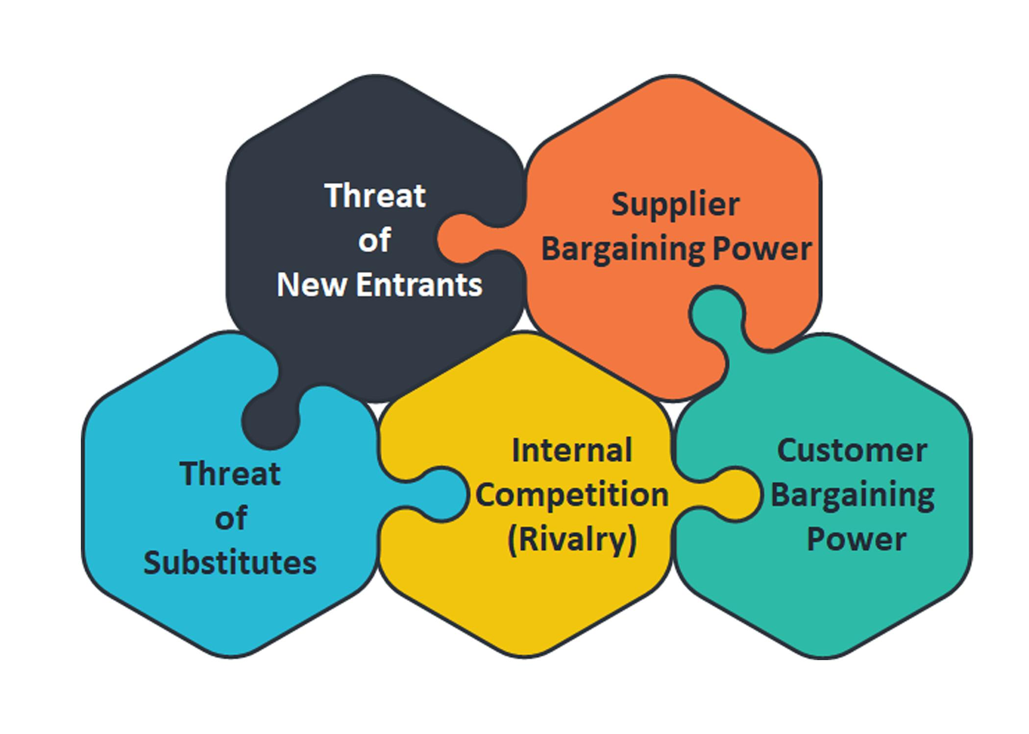
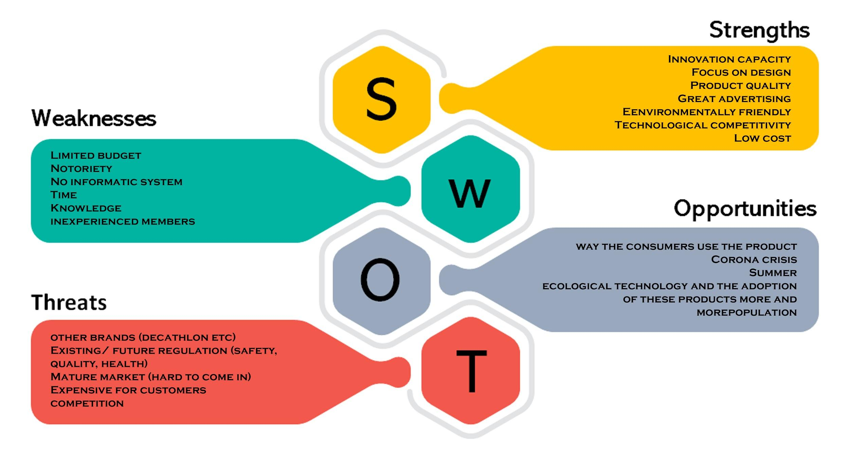
Progression – Marketing Plan

Slide 5
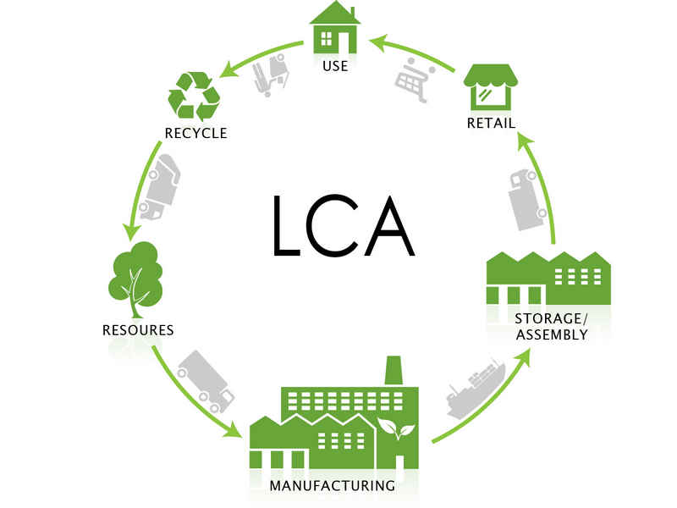
Progression – Sustainability
Sustainable development goals
Life Cycle Analysis

Slide 6

Progression – Ethic & Deontology
Engineering Ethics
Sales and Marketing Ethics
Environmental Ethics
Liability

Slide 7
Project Development

Slide 8
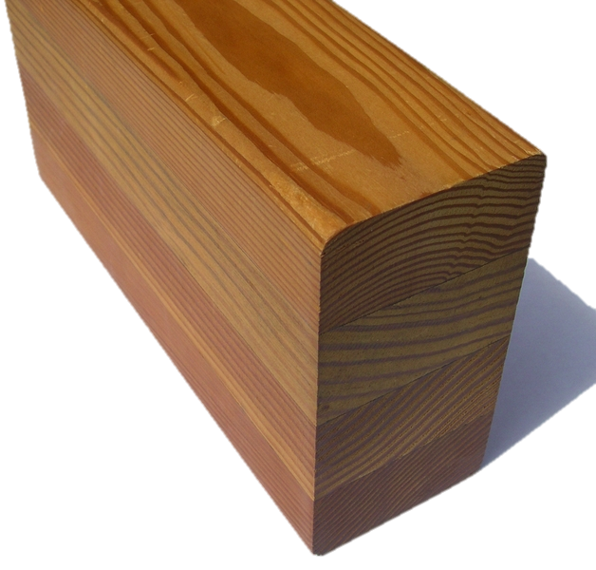

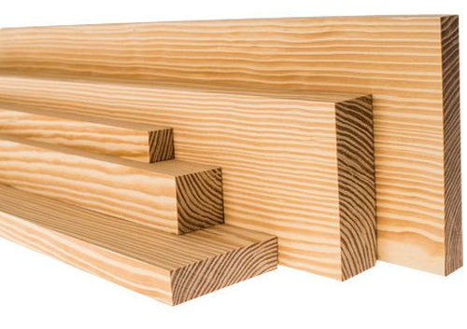

List of materials
Laminated Oak Wood
Cork
Spruce Wood Plate
Cotton

Slide 9
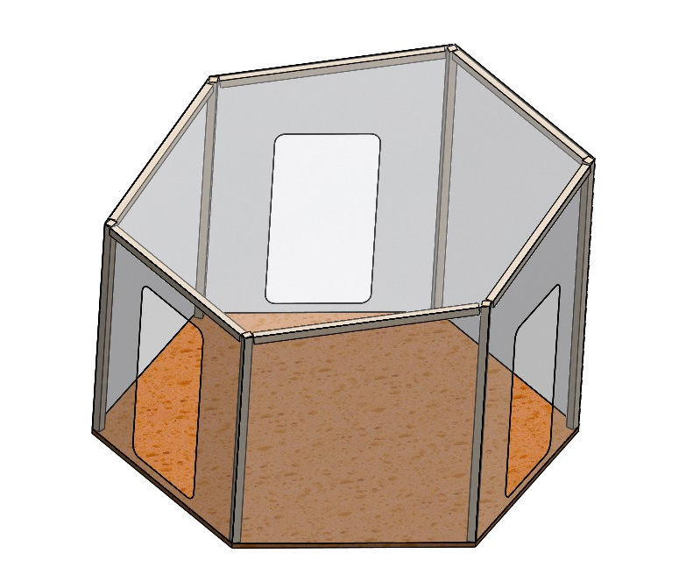
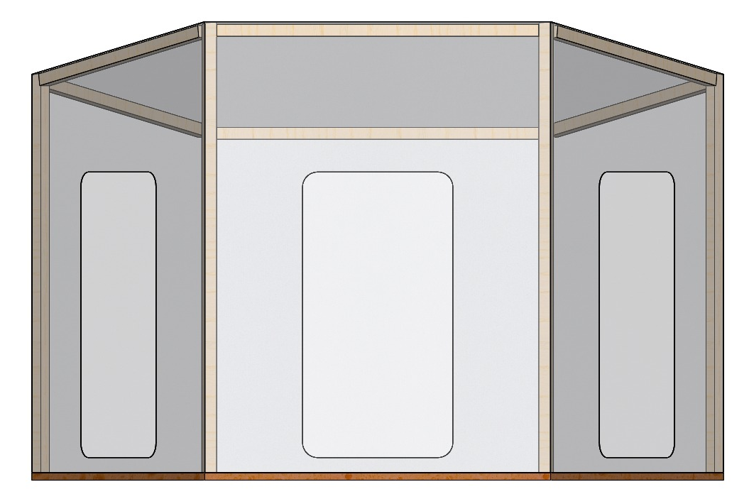
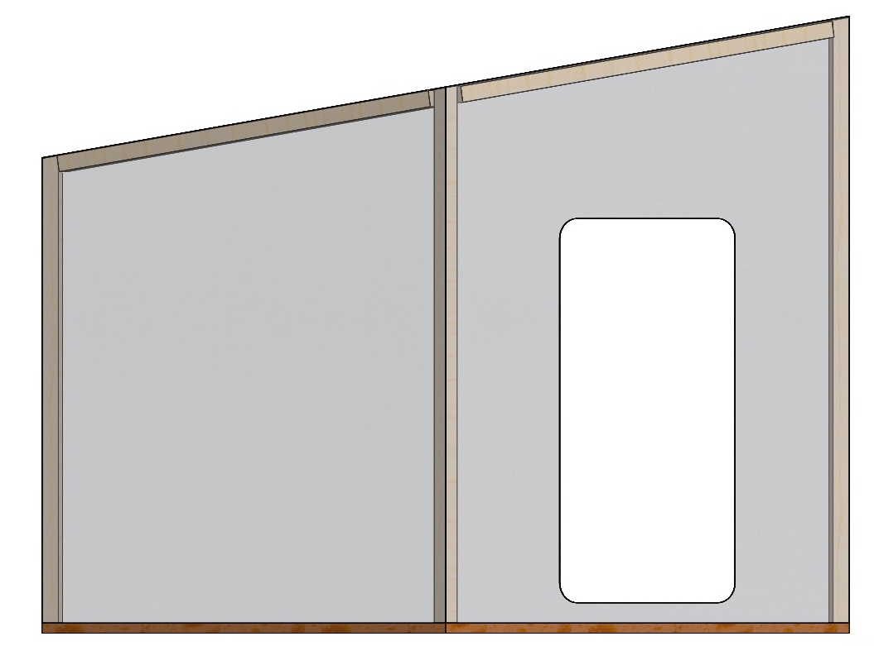
“SafeBIS for a new beginning”

Slide 10
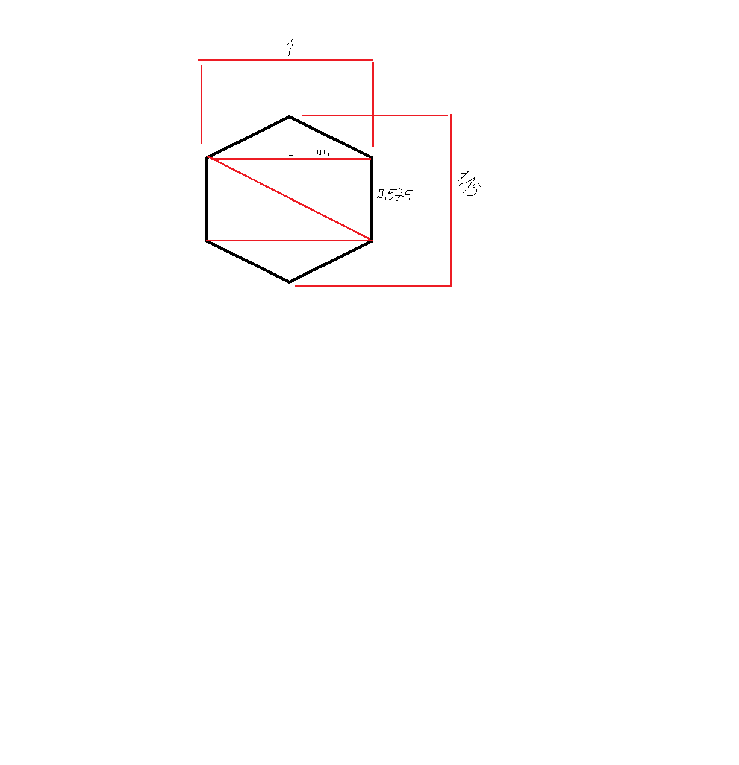
Next Steps
Results / functional tests 📊
Final list of Materials 🧾
Return to Portugal 🤞🤞🤞
Packaging Solution 📦
Final presentation 👨‍🎓
Demo prototype ⛺️
23/04/20
30/04/20
XX/05/20
06/05/20
13/05/20
02/06/20
12/06/20
16/06/20
19/06/20
23/06/20
Update 🔄
Final Report 📗
Final Video & CAD ⚙️
Refined interim report ✅

