Slide 1

The Foldable Disaster Shelter
Eduardo Pereira, Andreea Popescu, Gabriel Givanovitch, Jelte Bakker, Vladimir Dukoski, Lore Pauwels

Slide 2

Table of content
Situation
Objectives and requirements
Design
Sustainability implementation
Marketing implementation
The Shelter
Recommendations
Video and Website

Slide 3
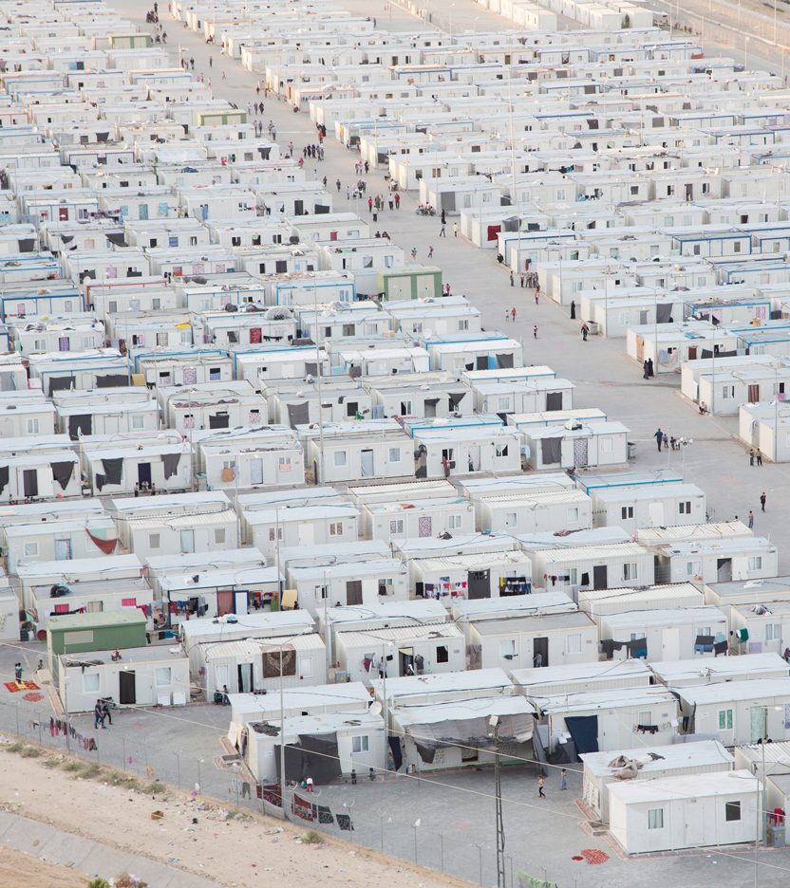
Situation
Disasters
Equatorial area
Loss of home
Shelter camps

Slide 4
Objectives and requirements
Protect victims
Foldable
Modular
Sustainable
Space effieciënt
Secure

Slide 5
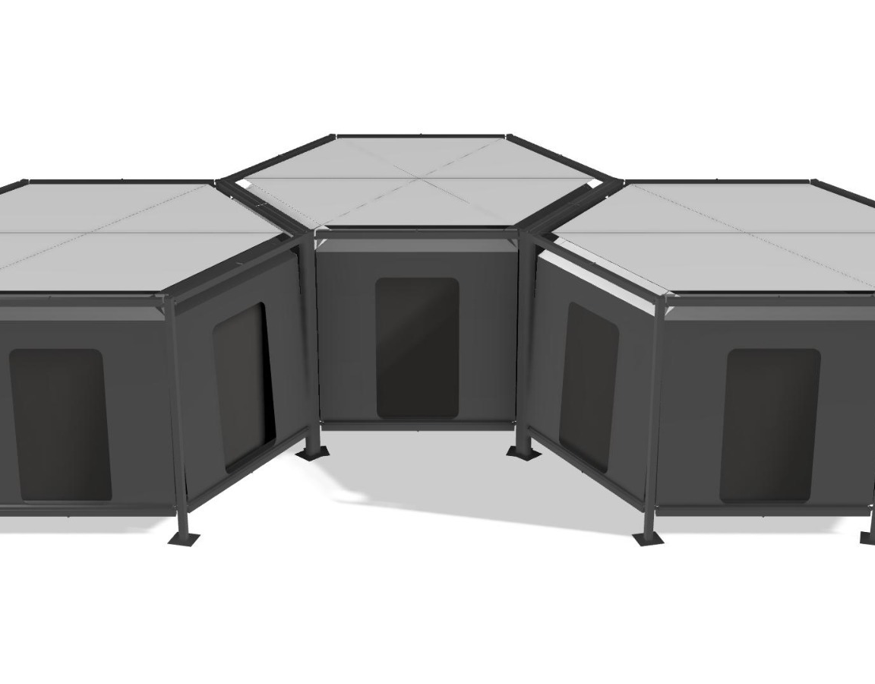

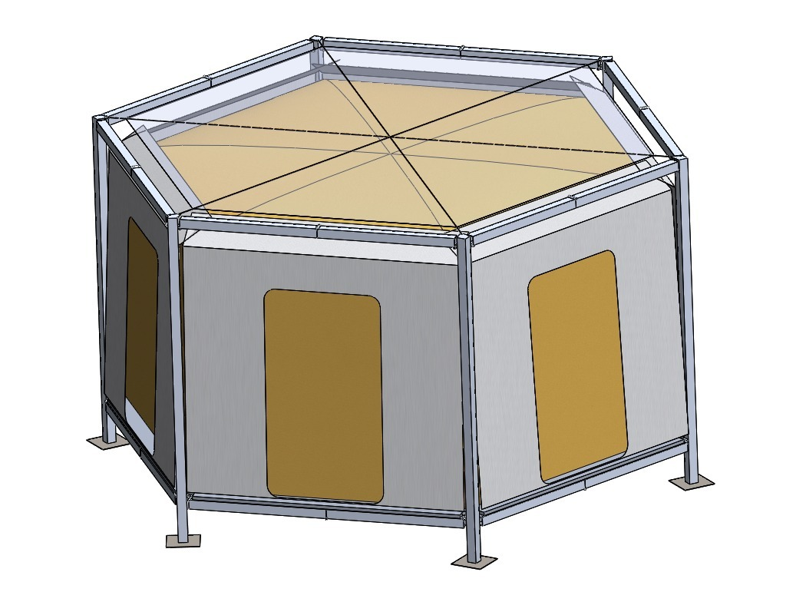
Design
Honey comb design
Robust
Secure
Stable
Modular

Slide 6


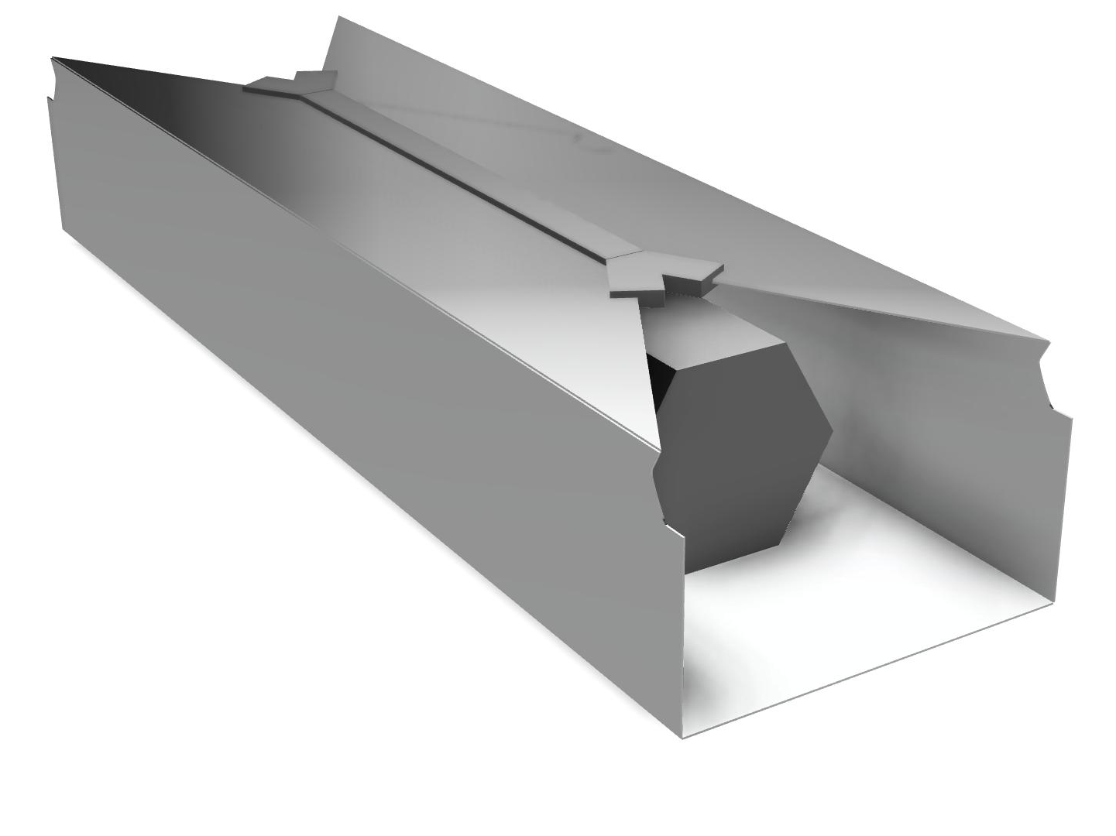
Sustainability implementation
Packaging solution
No waste
Materials
  Cork
  Aluminium
  Cotton

Slide 7
Marketing implementation
Safe BIS name
Unique design

Slide 8
The Shelter
Modular
Ventilation
Water accumulation
Steel cables
Double Fabric
Elevation

Slide 9
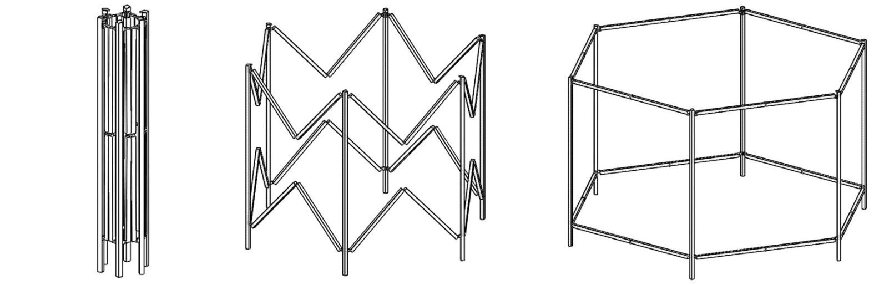
The Shelter
Retraction
Space efficiënt
Foldable

Slide 10
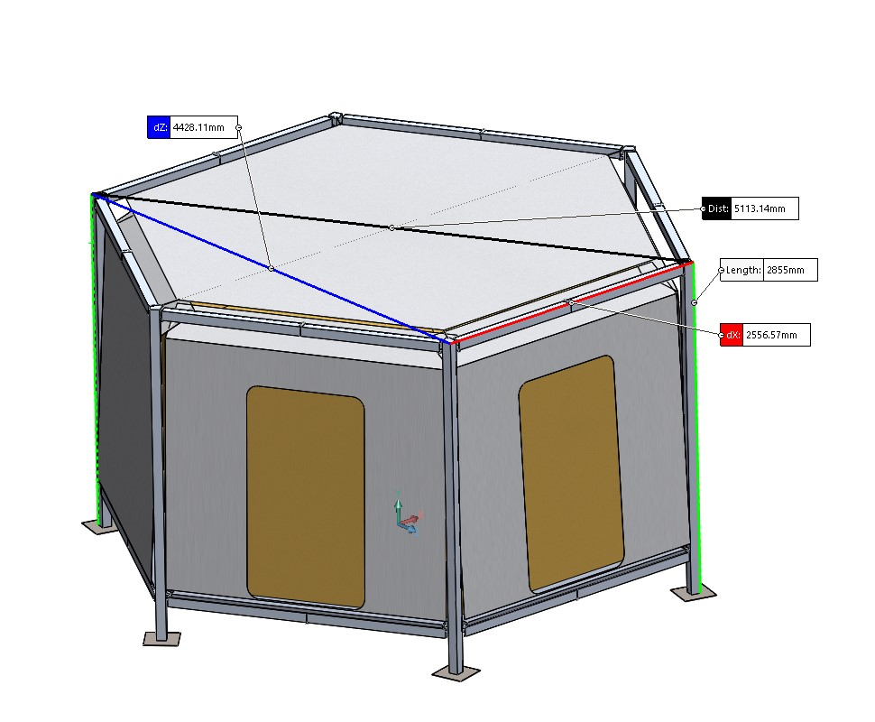
The Shelter
The dimensions and materials
Aluminium
Steel cables
Cotton
Cork

Slide 11
Recommendations

Slide 12

Video
https://bisshelters.wixsite.com/bisshelters
https://www.risendevelop.com/elementor-514/#

