Slide 1

12th
Meeting
SafeBIS SHELTER
TEAM BIS

Slide 2

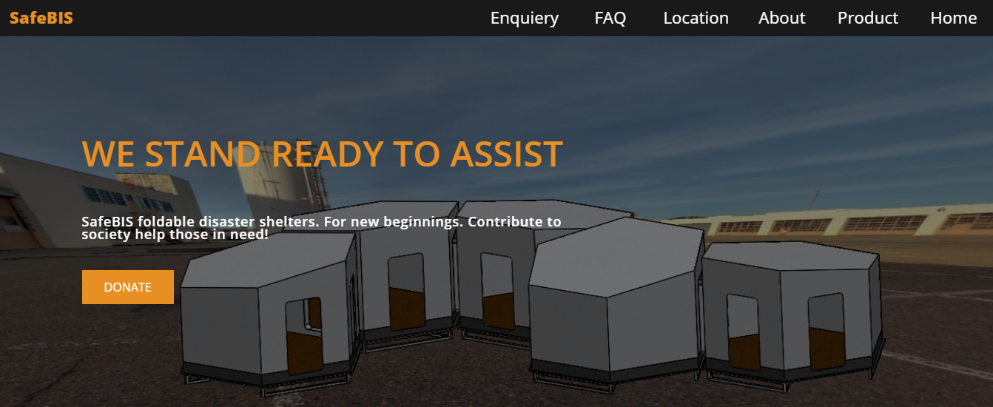
WEBSITE
https://www.risendevelop.com/elementor-514/

Slide 3
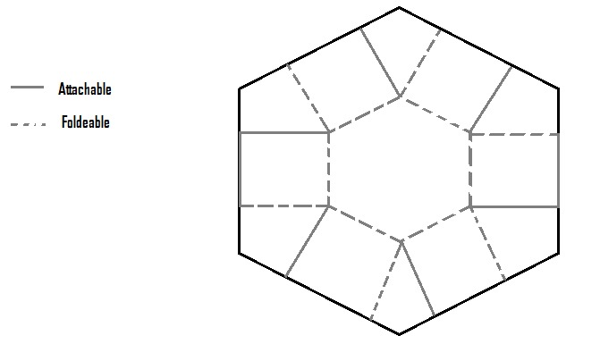
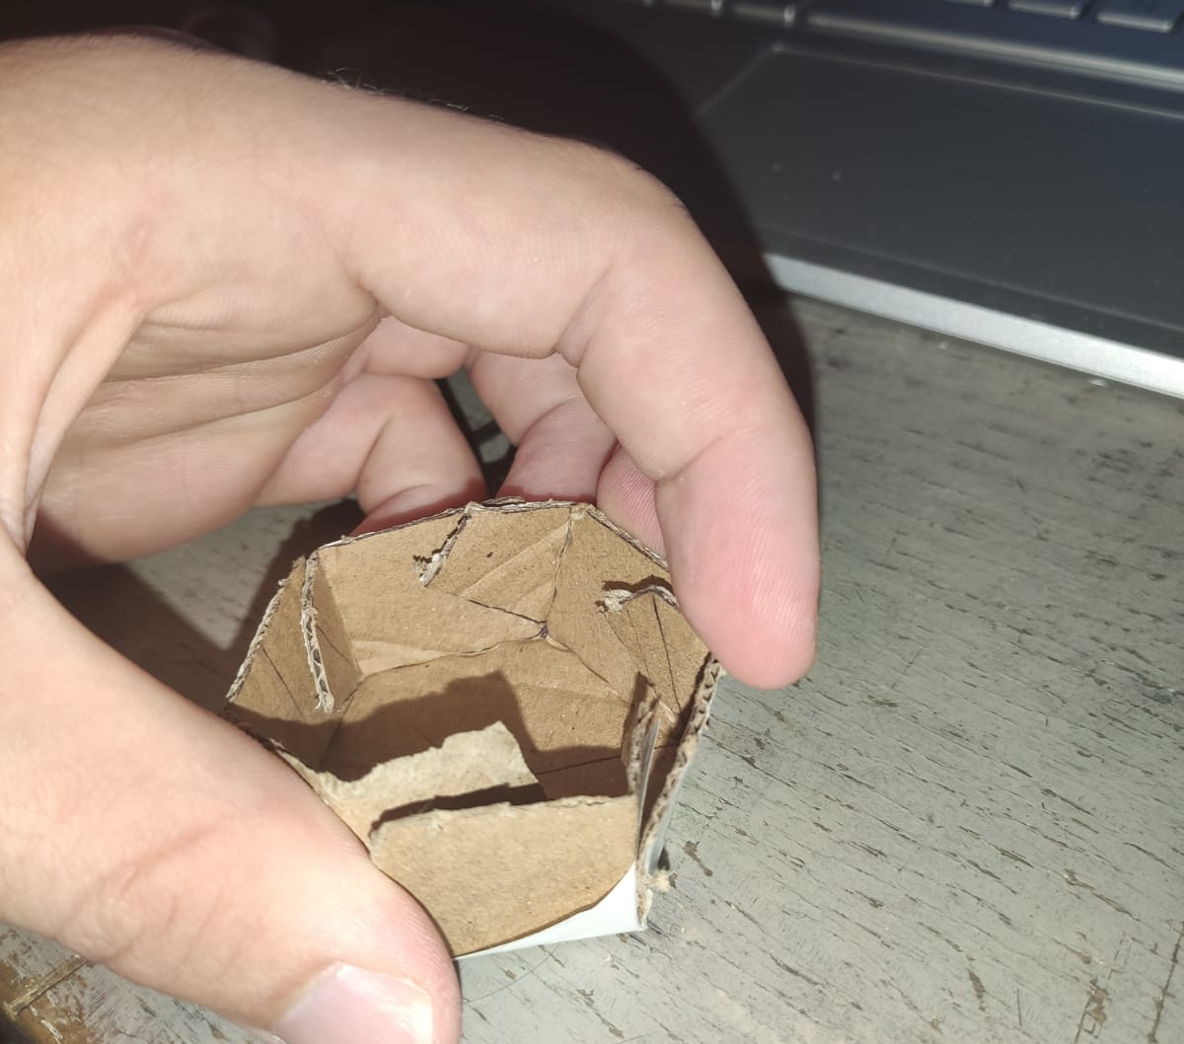
PACKAGING

Slide 4
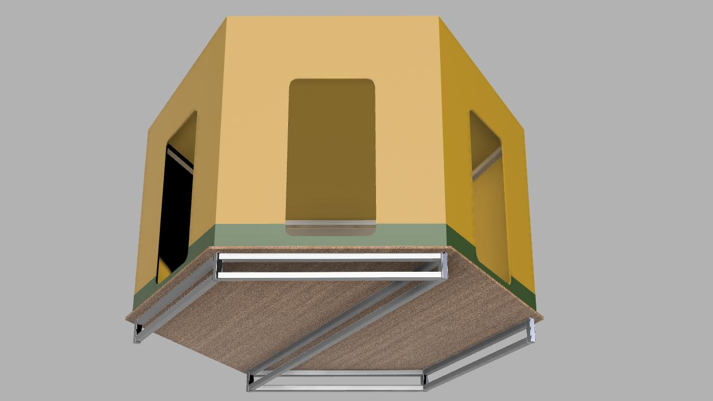
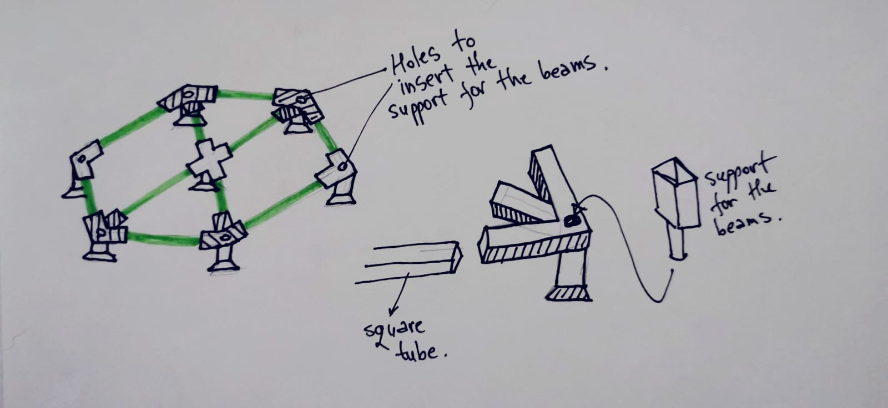
Bottom Support

Slide 5
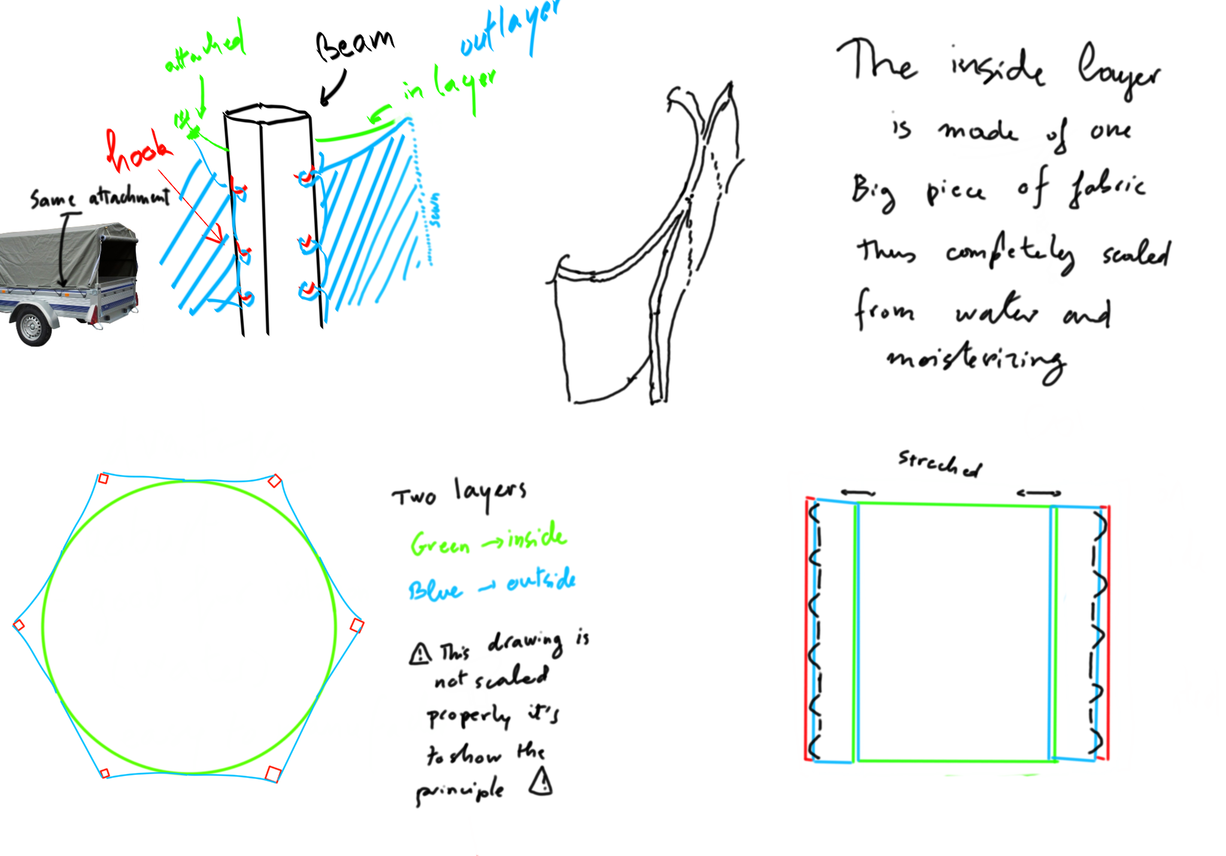
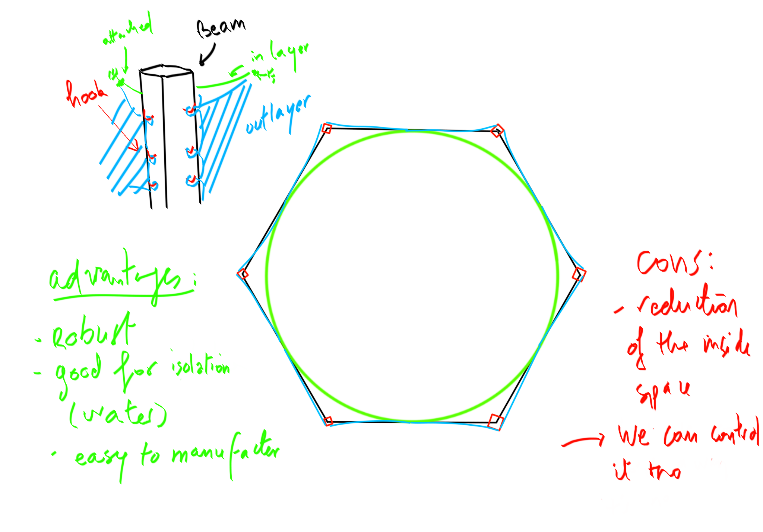
FABRIC CONNECTION TO SKELETON

Slide 6
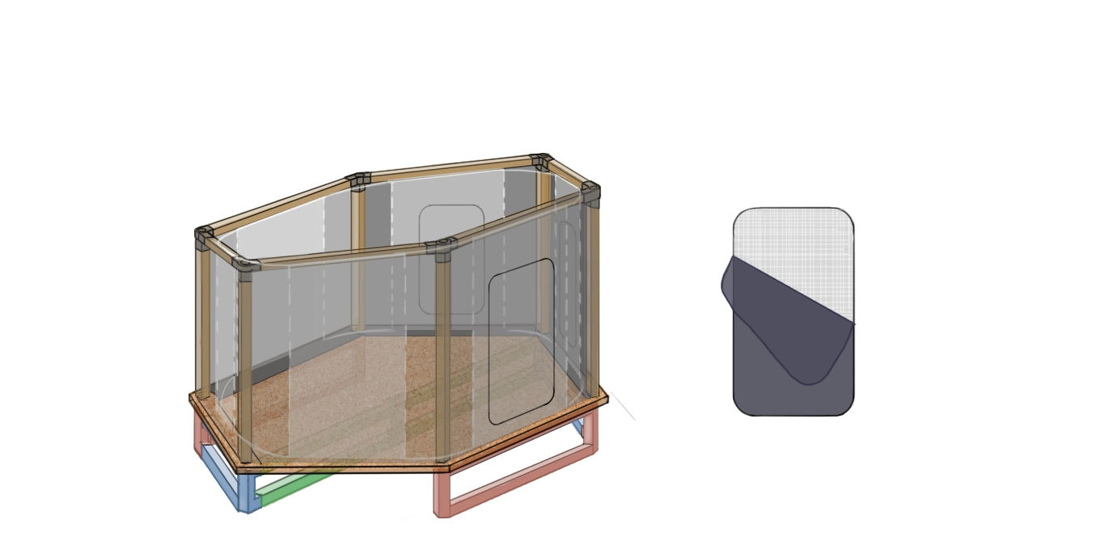
VENTILATION
3 doors
Double layered doors
Mosquito net x fabric
Question:
Do we need to provide an extra window on the opposite side for in case that 2 of the 3 doors are used for connection and only one door can be used for ventilation.

Slide 7

DISCUSSIONS

